Slide 1
Stargazing Terminology
OBJECTIVE 2
2020

Slide 2
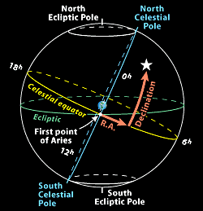
Declination: angular distance of a point north or south of the celestial equator (like latitude only in the sky) - Directly out from the Earth's equator, 0° latitude, is the celestial equator, 0° declination. If you stand on the Earth's equator, the celestial equator passes overhead. Stand on the North Pole, latitude 90° N, and overhead will be the north celestial pole, declination +90°.
Right ascension: like longitude only in the sky - Instead of counting in degrees, as with longitude around the Earth, right ascension is usually counted in hours, from 0 to 24 around the sky. This is just a different way of putting dividing marks on a circle. One hour in this scheme is 1/24 of a circle, or 15°.
Ecliptic: a great circle on the celestial sphere representing the sun's apparent path during the year

Slide 3
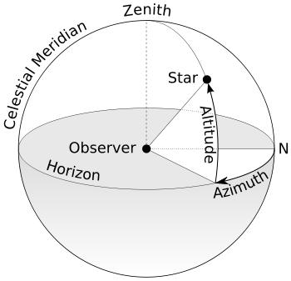
Altitude: distance an object appears to be above the horizon as measured by a sextant. The angle is measured up from the closest point on the horizon up to the zenith of the observer. (90*)
Azimuth: angular distance along the horizon to the location of the object. It starts due North and increases clockwise to 90º East, then 180º South and then 270º West and finally back to 0º North.
Stars that sit directly above the Earth’s North or South Pole are called Pole Stars.
North Star: Polaris, or the North Star, sits almost directly above the North Pole.
Southern Cross: used to find South, similar to Polaris (North Star)
Constellations: a group of stars forming a recognizable pattern that is traditionally named after its apparent form or identified with a mythological figure. Modern astronomers divide the sky into eighty-eight constellations with defined boundaries
Notes:
If you stretch out your arm and make a fist, then your fist covers about 10 degrees on your field of vision,
Finger = ~1*
Finger tip to first knuckle = ~3*
Middle knuckle = ~4*
Third knuckle = ~6*
Fist = ~10*
Hang loose = ~25*

Slide 4
resources
“Celestial Coordinates”
Eyes on the skies video clip

Slide 5
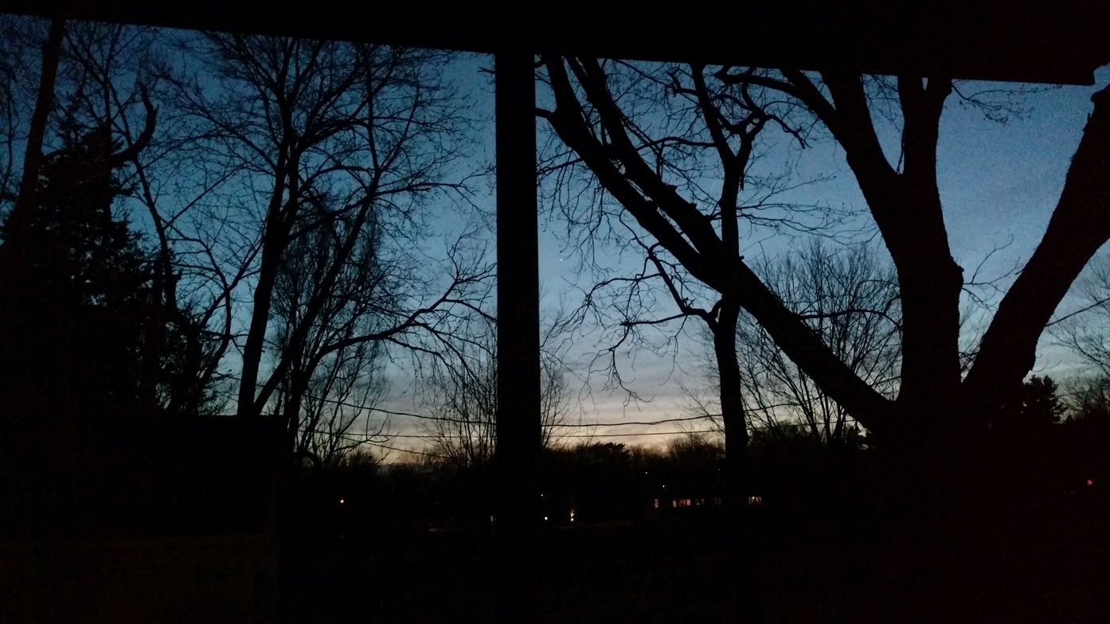
What information could we tell someone who would like to see Venus?
Notes:
What information could we tell some who would like to see Venus too?
Sunset → Sun sets in the west, so look that way…not too high up in the sky…
Altitude ~ 20* (0* - horizon, 90* zenith)
Azimuth ~ 280* (N 0*, E 90*, S 180*, W 270*)
Remember…
If you stretch out your arm and make a fist, then your fist covers about 10 degrees on your field of vision,
Finger = ~1*
Finger tip to first knuckle = ~3*
Middle knuckle = ~4*
Third knuckle = ~6*
Fist = ~10*
Hang loose = ~25*

Slide 6
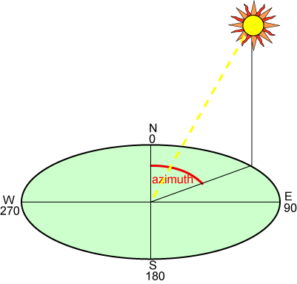
You could tell someone…
A. Sun sets in the west, so look that way…not too high up in the sky… Is that clear? Maybe not?
OR B. Look at an altitude of ~ 20* (0* - horizon, 90* zenith) Look at an azimuth of ~ 280*

Slide 7
Pretend the floor is the horizon…
Choose a star…and practice with a partner…
What do you need to know to find the altitude and azimuth?
Find the altitude and the azimuth.

Slide 8
review
Declination
Like latitude but in the sky
0* Equator
+90* North Pole
-90* South Pole
Right Ascension
Like longitude but in the sky
Starts at Prime Meridian
0-24 hours
1 hr = ~15*
Altitude
Height above horizon (up and down)
Angle measured with sextant
90* N = zenith
0* = horizon
Azimuth
Side to side
North = 0*
East = 90*
South = 180*
West = 270*
Notes:
If you stretch out your arm and make a fist, then your fist covers about 10 degrees on your field of vision,
Finger = ~1*
Finger tip to first knuckle = ~3*
Middle knuckle = ~4*
Third knuckle = ~6*
Fist = ~10*
Hang loose = ~25*

