Slide 1
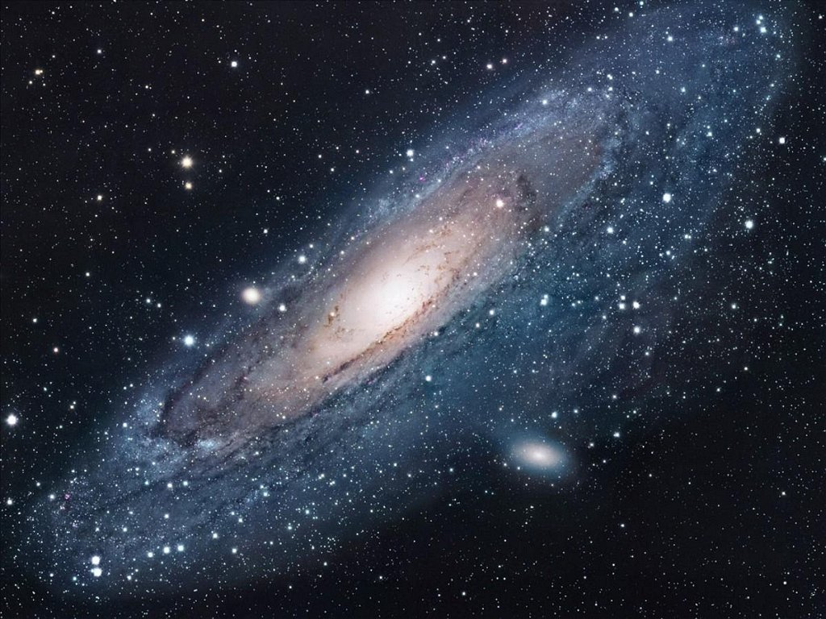
STAR PROPERTIES

Slide 2
Contelations
Ursa Minor (Little Dipper)
Ursa Major (Big Dipper)
Cassieopa
Cepheus
Draco
Orion
Bootes
Capella
Castor & Pollux (Gemini)
Corona Borealis
Saggitarius
Hercules
Fomahault (Pieces)
Andromeda and Pegasus
Lyra
Cygnus
Aquila
Summer Triangle
Delphinus
Scorpius
Canis Minor
Canis Major
Leo

Slide 3
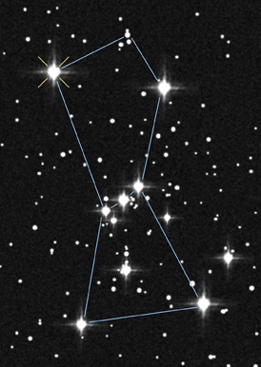
How Many Stars in Orion?
25
8
100
>1,000,000

Slide 4
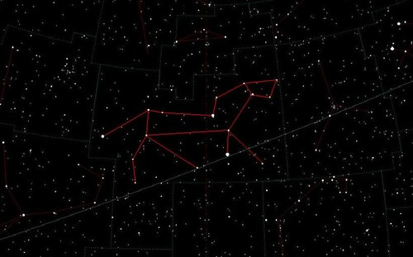
How Many Stars in Leo?
25
16
100
>1,000,000

Slide 5
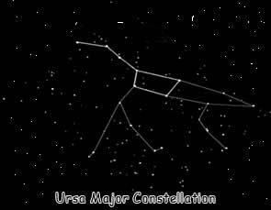
How Many Stars in Ursa Major?
50
21
100
>1,000,000

Slide 6
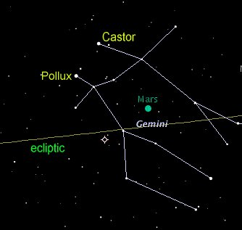
How Many Stars in Gemini?
15
21
100
>1,000,000

Slide 7
Answers
Orion >1,000,000
Leo > 1,000,000
Ursa Major >1,000,000
Gemini >1,000,000

Slide 8
Properties of Stars
Constellation – 88 total
More stars in constellation than found in pattern
Millions upon millions of stars in each

Slide 9
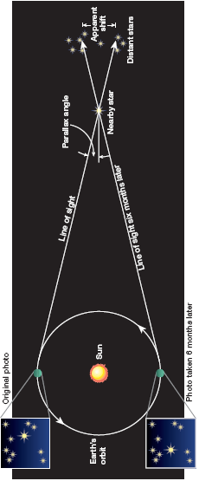
Properties of Stars - Distance
Parallax – basic way to measure distance
Stars positions appear to shift based on season
Smallest angle shift = farther away
Largest angle shift = closest
Notes:
Parallax: a shift in the apparent position of a star due to the movement of Earth.
Do thumb in front of face with one eye open and one eye closed….

Slide 10
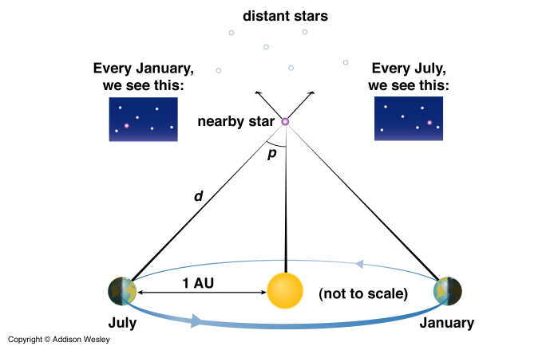

Slide 11
Properties of Stars - Distance
Measured in light-years – distance light travels in one year (9.5 x 10¹² or 9.5 trillion kilometers)
LIGHT-YEAR MEASURES DISTANCE
NOT TIME
Astronomical unit (AU) – 1 AU is the distance between the Sun and Earth
Our closest star (other than the sun) is 4.3 light-years away.
Notes:
The Sun is 8.3 light minutes away. How could you calculate how many light years it is?
The sun is approximately 0.0000158 light years from Earth
Parsec (1 parsec = 3.26 light-years), Light-years (1 light-year = 9.46X10^15 meters), AU (1 astronomical unit = 93 million miles or 1.50x10^11 meters), km, mi

Slide 12
Properties of Stars - Mass
Binary Stars - pairs of stars pulled together by each other’s gravity
Gravity pull determined by mass
The bigger the mass the greater the pull
Difference in center of masses allows calculations of both star masses
About 85% of the single points of light we observe in the night sky are actually two or more stars orbiting together. (in the Milky Way)
Notes:
A star twice as massive as its partner is twice as close to the center of mass. Therefore it has a smaller orbit than its less massive partner.

Slide 13
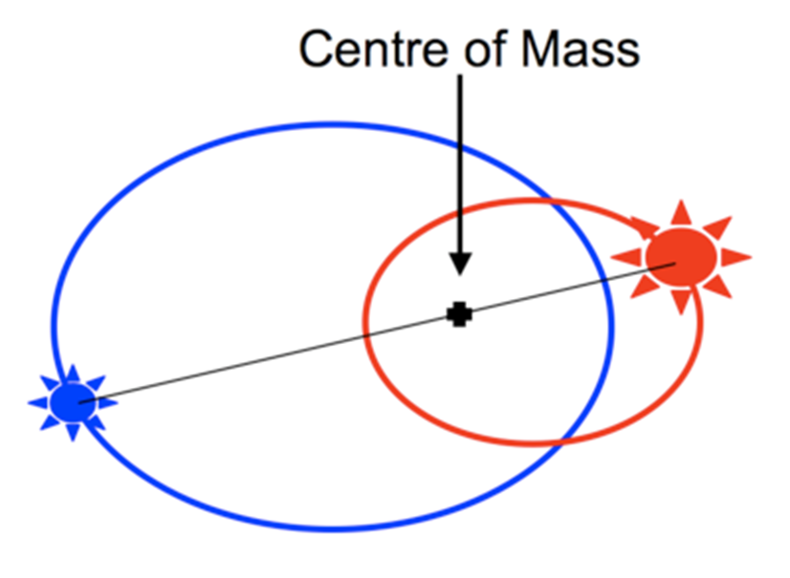
Notes:
Bigger star, red, has a stronger gravitational pull on the smaller star, blue.
Nova – comes from white dwarf steadily accreting matter from a nearby companion star.
??? When the white dwarf reaches a mass threshold of 1.4 solar masses, the entire white dwarf explodes with a flash of carbon fusion.

Slide 14
Types of Binary Stars
Wide binaries – stars evolve separately
Close binaries – transfer mass, sometimes can consume the other
Visual binaries – far enough apart to view both stars (5-10%)
Spectroscopic binaries – appear close, must study wavelengths to study
Eclipsing binaries – orbits cause eclipse from Earth
Astrometric binaries – companion star cannot be identified
Double stars – appear close, but aren’t

Slide 15
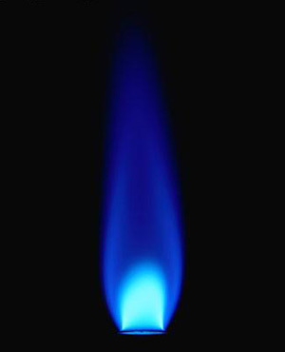
Which Flame?

Slide 16
Properties of Stars - Temperature
A star’s color tells us about its temperature!
Blue = very hot (30,000 K)
Yellow = medium (5,000 K)
Red = cool (2,000 K)
K = Kelvin, a type of temperature.
K = °C +273
Blue
White
Yellow
Orange
Red
Hottest
Coolest
Notes:
But the hottest known stars in the Universe are the blue hypergiant stars. These are stars with more than 100 times the mass of the Sun. One of the best known examples is Eta Carinae, located about 7,500 light-years from the Sun.

Slide 17
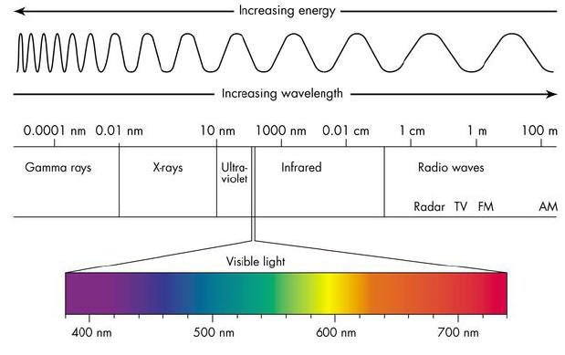
Properties of Stars – Temperature cont.
Different colors based on energy emitted
More energy shorter wavelength = blue
Less energy longer wavelength = red

Slide 18
Properties of Stars - Brightness
Apparent Magnitude: brightness of a star as it looks from Earth
Depends on how big it is, how hot it is, and how far away it is.
Absolute Magnitude: how bright a star actually is from 32.6 light years away
Based on distance away – abs. mag. Sun = 5
less than 5 brighter than Sun
Greater than 5 dimmer than Sun
Negative numbers mean that the star is very bright!!!

Slide 19
Properties of Stars – Brightness cont.
Luminosity is the measure of the energy output from the surface of a star per second.
This is based on the star’s apparent magnitude and how far away it is.
Sun = 3.85x10²⁶ Watts = 3.85x10²⁴ W 100 W lightbulbs!
No stellar property varies by so much!
From .0001 to more than a million times the Sun’s
Notes:
Other stars vary from about .0001 to more than a million times the sun’s luminosity!

Slide 20
Check for Understanding:
If I compare the brightness of two stars from where I am standing on Earth, am I using apparent or absolute magnitude?
What color of star is the hottest?
What are common units of distance when talking about astronomy?
Notes:
Apparent
Blue
Parsec (1 parsec = 3.26 light-years), Light-years (1 light-year = 9.46X10^15 meters), AU (1 astronomical unit = 93 million miles or 1.50x10^11 meters), km, mi

Slide 21
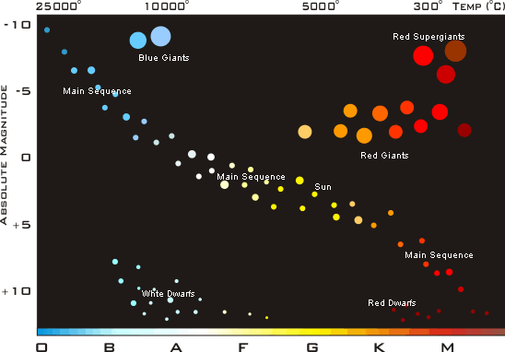
Hertzsprung-Russell Diagram
Notes:
Temperature and spectral type is x axis
Absolute magnitude is on y axis

Slide 22
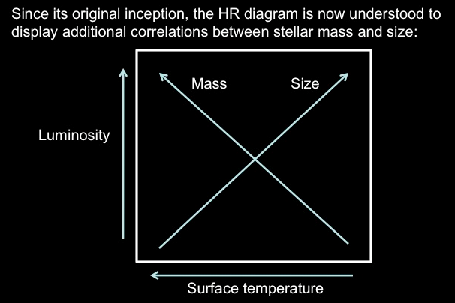
HR Diagram

Slide 23
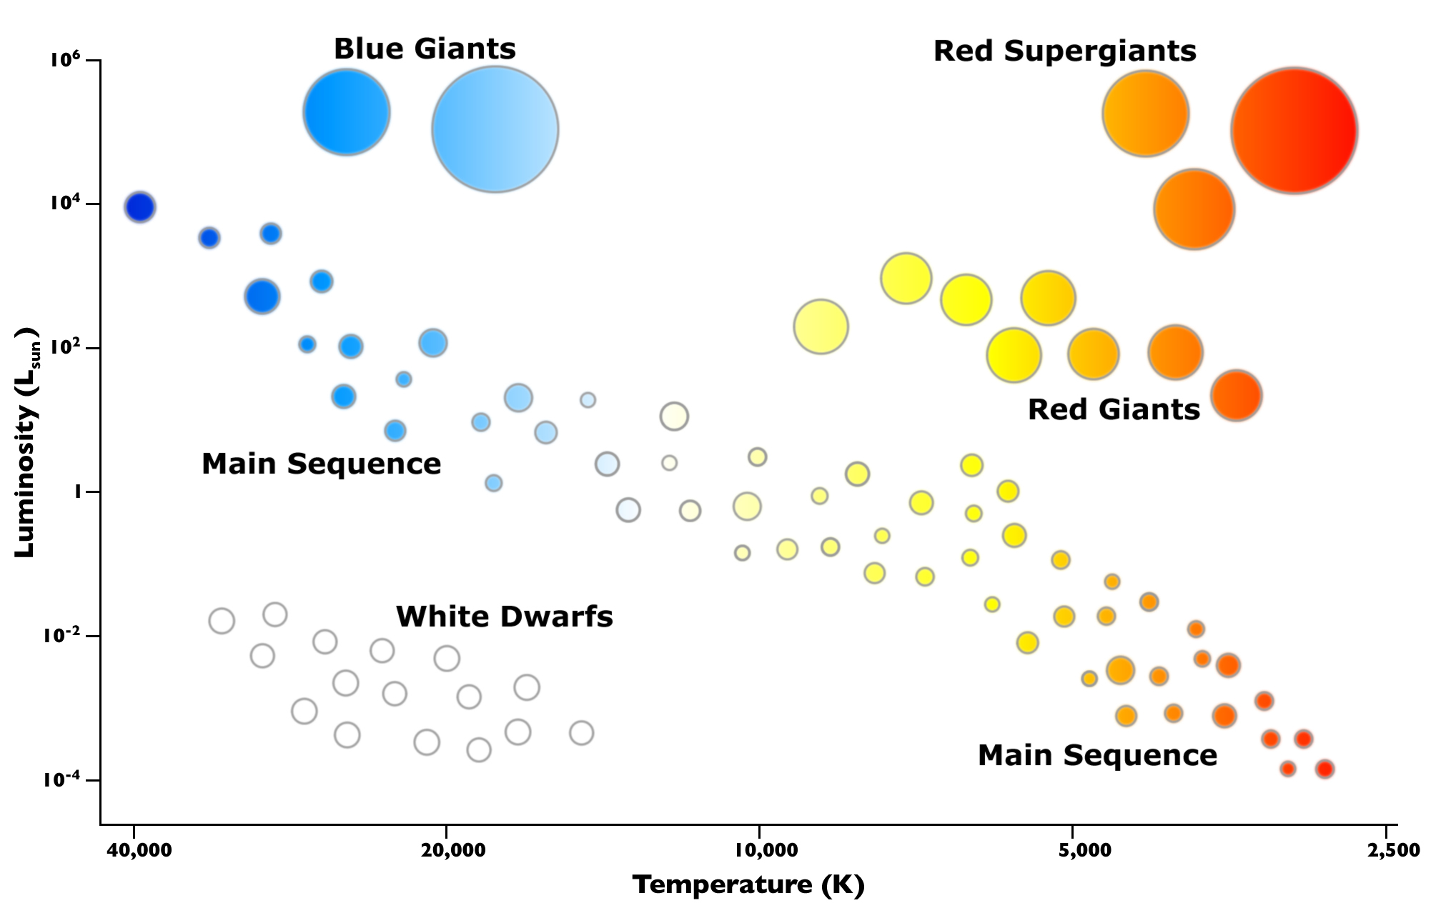
Hertzsprung-Russell Diagram
Hottest Stars:
On the left side
Brightest Stars:
At the top
Biggest stars? Giants and Supergiants
Smallest stars?
White dwarfs

Slide 24
Stars fluctuate in brightness – Variable Stars
Pulsate in brightness because of the expansion and contraction of their outer layers
Cepheid stars – get brighter and fainter in a regular pattern
Comparable to a street lamp
Longer periods – larger absolute magnitude
Distance can be measured by comparing the absolute magnitude and the apparent magnitude.
Nova – sudden brightening of a star (white dwarf)
Small amount of mass lost during surge
Due to energy transfer in binary stars from bigger to smaller star
Notes:
Variable stars occur bec fuel runs out and they are unstable and pulsate
Cephied - A type of variable star which exhibits a regular pattern of changing brightness as a function of time. The period of the pulsation pattern is directly related to the star's intrinsic brightness. Thus, Cepheid variables are a powerful tool for determining distances in modern astronomy. Pg 834
Nova - Hydrogen-rich gas from the oversized red giant is transferred by gravity to the white dwarf. The added gas causes the dwarf to ignite explosively. This heats and expands the outer layer of the hot dwarf to produce a nova. Then the white dwarf returns to its prenova state, where it remains inactive until the next buildup occurs.

Slide 25
Nebulae
Clouds of dust and gas
Mostly hydrogen
Absorb UV light
Reflected nebulae – reflect light from near star
Dark nebulae
not very dense, but more mass than sun

Slide 26
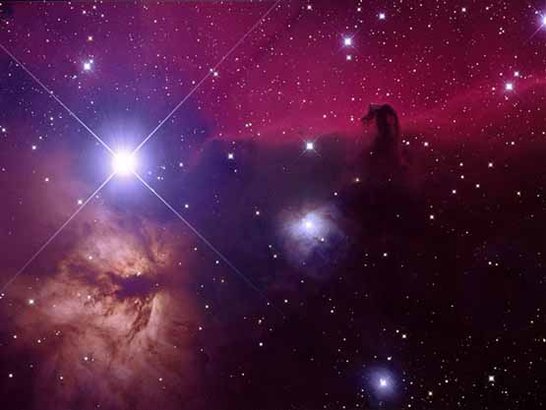

Slide 27
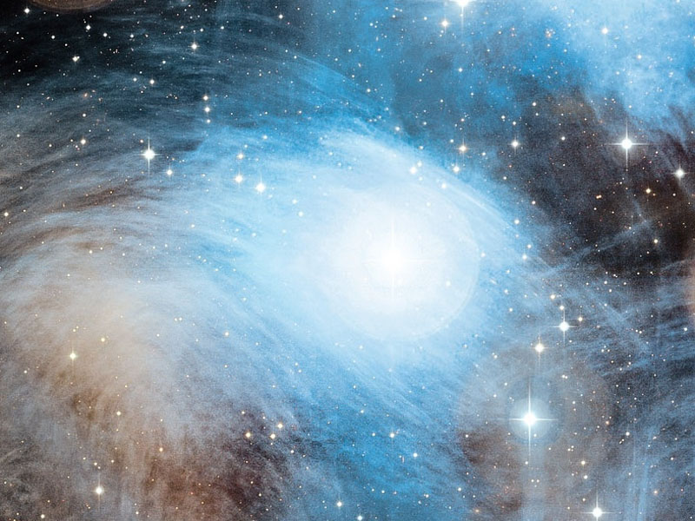

Slide 28
Recap
1. What are some properties of stars we discussed? Explain each.
2. Why do astronomers use parallax? Describe the process.
3. Compare and contrast apparent and absolute magnitude.
4. What does an HR Diagram tell astronomers? What are the axes labeled?
Notes:
Distance (parallax, binary stars, absolute magnitude – light years, AU, etc.), mass (binary stars, center of mass), color/temperature (blue is hot, red is cool), brightness (absolute and apparent magnitude, small/neg # = brighter, larger # = dimmer), luminosity (energy output)
To find the distance to each star from Earth, bigger angle = closer star, smaller angle = farther star
Both tell brightness. Apparent = how bright appears from Earth. Absolute = how bright it really is.
HR Diagram relates temperature, brightness, and star type. X axis is temp and star classification, Y axis is brightness.

