Slide 2
H - Tuesday, May 8, 2012
Question of the day: Fusion – What is it? So if you have two H atoms fusing what element do you get?
Objective: I can outline the life cycle of a star.
Honors HW: Work on your check off sheet. Turn in all missing assignments so you can go to reward day Thursday!!

Slide 3
Review
Fusion – What is it?
Combining of atoms to make a different element
Number of proton determines different element
So if you have two H atoms fusing what element do you get?
Answer: Helium
Reaction releases a lot of heat.

Slide 4
Star Birth
What do you know about how stars are born?
Think back to the Nebular Theory and how it explains the formation of our Solar System?
What are the parts of our Solar System?

Slide 5
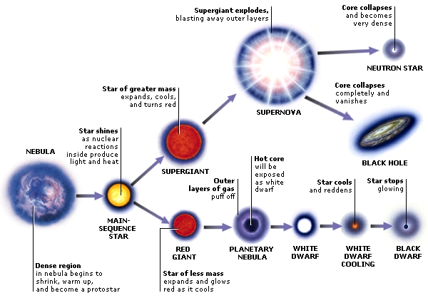
protostar

Slide 6
Role of Mass
Mass determines the entire life story of a star, because it determines its core temperature.
Low-mass stars have _____ lives, never become hot enough to fuse beyond carbon nuclei, and end as white dwarfs.
High-mass stars have _____ lives, eventually becoming hot enough to make iron, and end in supernova explosions.
Notes:
Low mass = long lives
High mass = short lives

Slide 7
Star Birth: Stellar Nebula
1. Dark, cool interstellar clouds made of dust and gas (Nebulae!) are where stars are born.
2. Not sure why, but some nebulae become dense and contract pulling every particle toward the center
Nebula shrinks and gravitational energy is converted into heat energy.
Notes:
Milky Way nebulae consist of
92% hydrogen, 7% helium, and less than 1% of heavier elements

Slide 8
2. Protostar
The contraction spans millions of years
Temperature slowly rises until it radiates red light
Protostar – developing star not yet hot enough to engage in nuclear fusion
When the core of a protostar has reached ~10 million K, pressure within is so great that nuclear fusion of hydrogen begins, and a star is born.

Slide 9
3. Main Sequence Stars
Stars that fuse hydrogen to helium
NOT on main sequence → do not fuse hydrogen in cores or no fusion at all

Slide 10
3. Main-Sequence Star
Heat from hydrogen fusion → gasses increase motion → outward gas pressure
When outward gas pressure = inward force of gravity ➔ stable main-sequence star!
Hydrostatic equilibrium
This fusion provides outward pressure so star doesn’t collapse because of gravity or expand due to repulsion

Slide 11
Main-Sequence Star
Usually star stays in this stage for a few billion years while hydrogen fusion continues
90% of a star’s life is main-sequence
Hot, massive blue stars deplete H fuel after a few million years
Less massive stars burn for hundreds of billions of years
Yellow star, like our sun, will remain main-sequence for ~10 billion years
Notes:
Sun has been burning main sequence for about 5 billion years. In about 5 billion years, its hydrogen fuel will run out.
180 million degrees then can fuse He to C.
All the action happens in the last 10% of its life.

