Slide 1
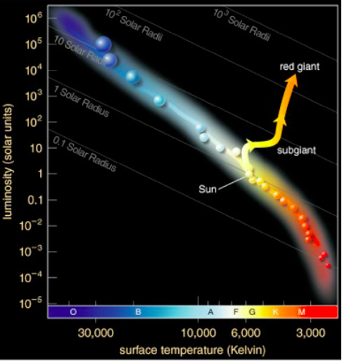
Life After Main Sequence
H burning in core ends
Core contracts, heats, brightens
Star ascends the red giant branch.

Slide 2
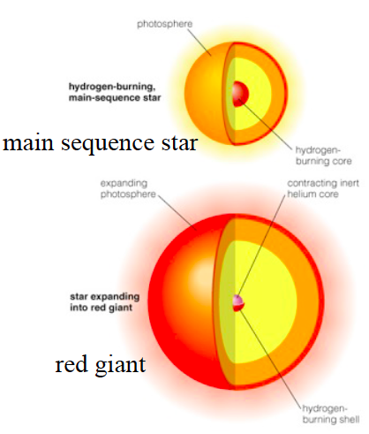
4. Red Giant
H will fuse to He in shell around core.
As core contracts:
temp increases
nuclear reaction rates of H in shell increase
luminosity increases
RED GIANT
Notes:
Energy produced in hydrogen shell fusion forces outer layers of the star to expand and cool

Slide 3
Helium Flash
At a critical temperature and density, He fusion suddenly begins
Astronomers have not and will not ever see this.
Check for Understanding 1
Check for Understanding 2

Slide 4
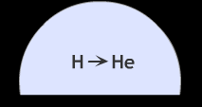
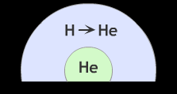
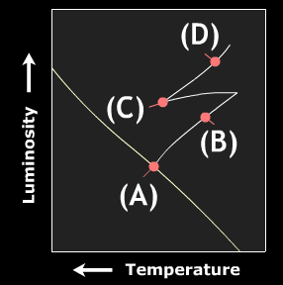
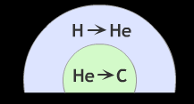
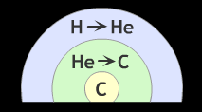
In other words…
(A) Main Sequence
(B) Red Giant
(C) Helium Flash
(D) Red Supergiant

Slide 5
5A. Planetary Nebula
Double-Shell Burning: Helium in the core gets used up, Carbon core left, Helium continues to fuse in shell around core
Double-shell burning ends with pulse that ejects H and He into space as planetary nebula.
The core left behind becomes a white dwarf.

Slide 6
6A. White Dwarf
Extremely small stars (about size of Earth)
Very hot (25000 K)
Very stable
Very dense - Spends eternity cooling off, eventually going dark entirely
Composition depends on how many reaction phases it goes through.
Notes:
Stability - Electrons forced together by gravity, heat released (degeneracy pressure)
Density - made of material heavier than anything on Earth! (1 spoon = several tons!)
Type IA Supernova in binary system

Slide 7
7A. Black Dwarf
As the fuel runs out, the star cools and gets less bright.
Eventually it stops burning.
Temp of CMB
Cosmic Microwave Background

Slide 8
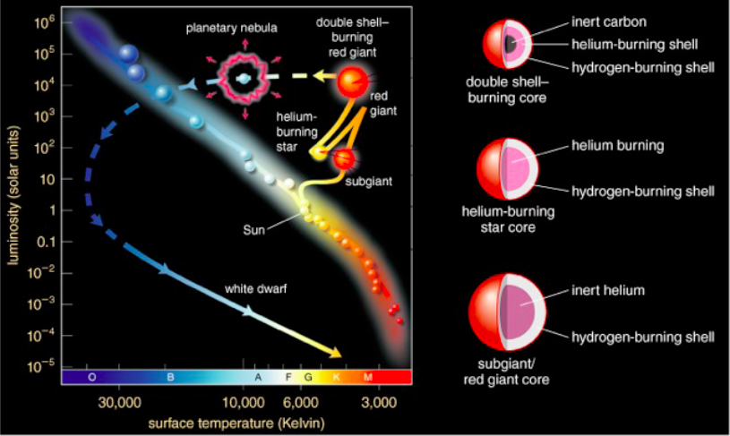
Sun-like Star

Slide 9
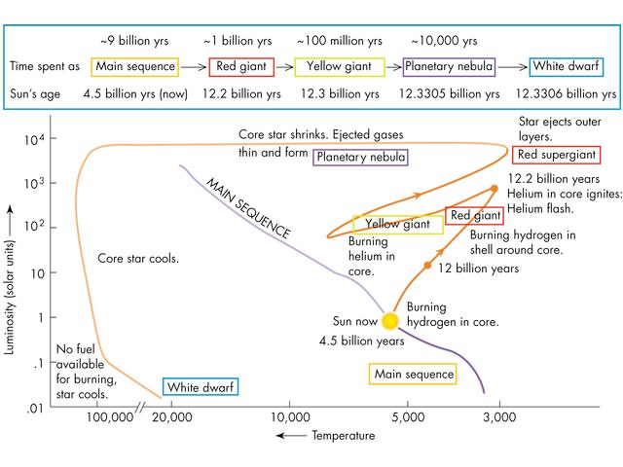

Slide 10
Is our sun a very light star or a middle mass star?
Answer: low/middle
Stars less massive than our sun have the same life cycle, but do not have C cores as white dwarf, have He cores
Less energy for fusion because less gravity

