Slide 1
Behavior of Gases
Chapter 3.2

Slide 2
Behavior of Gases
What behaviors do gases display?
Do they behave the same all the time?
What variables are involved with gas behavior?

Slide 3
Variables
Pressure – the amount of collisions between gas particles and walls of the container (balloon). Measured in kilopascals (kPa).
Temperature – the speed of the gas molecules. Measured in Kelvin (K).
Volume – amount of space of the container. Measured in Liters (L).
# particles – moles (n)

Slide 4
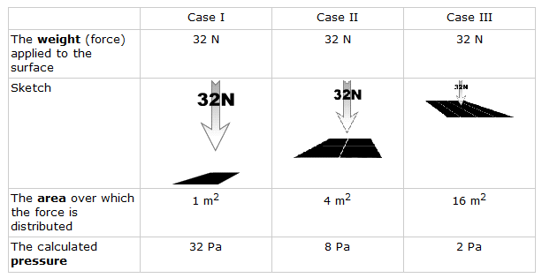
Behavior of Gases – pg 502-07
Pressure = Force/Area (P = F/A)
Unit: Pascals (Pa) = 1 N/m²
At sea level, atomospheric pressure = 101.3 kilopascals (kPa)
**Sketch picture & chart !
Notes:
Standing on a bed of nails vs laying on a bed of nails

Slide 5
Common Units of Pressure
Atmosphere (atm)
Bar (usually seen in millibars)
Millimeter of Mercury (mmHg)
Pounds per Square Inch (psi)
kilopascal (kPa)
Conversions:
1 atm = 1013.25 millibars = 101.3 kPa = 14.7 psi = 760 mmHG

Slide 6
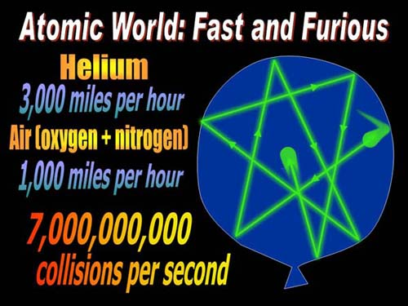
Behavior of Gases
Balloons stay inflated because of the atoms colliding with the walls of the container.
If you add air to the balloon, there are more air particles. Therefore, more collisions are occurring and the container expands.

Slide 7
Gas Laws
The gas laws will describe HOW gases behave.
Gas behavior can be predicted by the theory.
The amount of change can be calculated with mathematical equations.
You need to know both of these: the theory, and the math

Slide 8
Robert Boyle (1627-1691)
Boyle was born into an aristocratic Irish family
Became interested in medicine and the new science of Galileo and studied chemistry
Wrote extensively on science, philosophy, and theology.

Slide 9
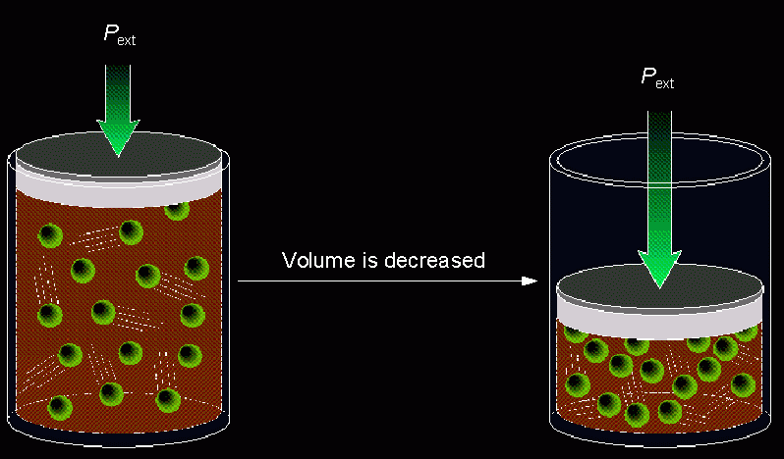
#1. Boyle’s Law - 1662
Gas pressure is inversely proportional to the volume, when temperature is held constant.
Pressure x Volume = a constant
Equation: P₁V₁ = P₂V₂ (T = constant)
Notes:
Examples??

Slide 10
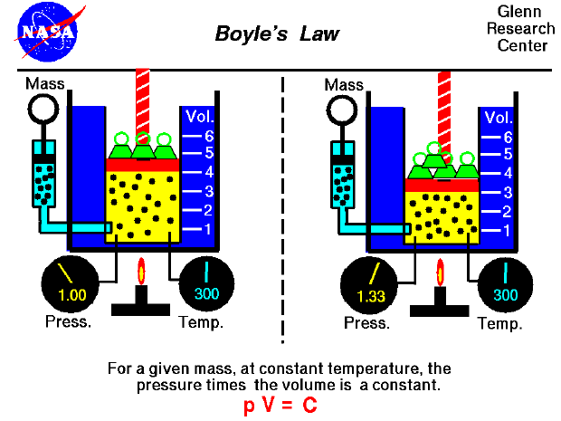
Boyle’s Law

Slide 11
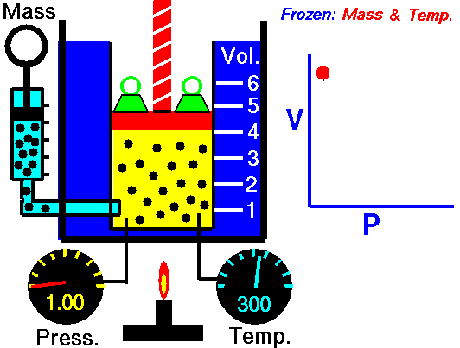
Boyle’s Law
↓ volume = ↑pressure (constant temperature)

Slide 12
Boyle’s Law
P₁V₁ = P₂V₂
Example:
A balloon has a volume of 10.0 L at a pressure of 100 kPa. What will the new volume be when the pressure drops to 50 kPa?
P₁ =
V₁ =
P₂ =
V₂ =
P₁V₁ = P₂V₂
100 * 10 = 50 * V₂
1000 = 50 * V₂
1000 = 50* V₂
50 50
100 kPa
10.0 L
20 L = V₂
50 kPa
20 L

Slide 13
Joseph Louis Gay-Lussac (1778 – 1850)
French chemist and physicist
Known for his studies on the physical properties of gases.
In 1804 he made balloon ascensions to study magnetic forces and to observe the composition and temperature of the air at different altitudes.

Slide 14
#2. Gay-Lussac’s Law - 1802
The pressure and Kelvin temperature of a gas are directly proportional, provided that the volume remains constant.
What happens when you heat a container that can’t change shape (volume is held constant)?

Slide 15
Sig figs C → K
Convert:
Add 273
25ºC → _____K
25.0ºC → _____K
100ºC → _____K
100. ºC → _____K
100.0ºC → _____K
When you ADD, you round in the middle of the problem!!!!
Notes:
298K
298.0K
400K
373K
373.0K

Slide 16
Jacques Charles (1746 - 1823)
French Physicist
Part of a scientific balloon flight on Dec. 1 1783 – was one of three passengers in the second balloon ascension to carry humans
This is he became interested in gases
The balloon was filled with hydrogen!

Slide 17
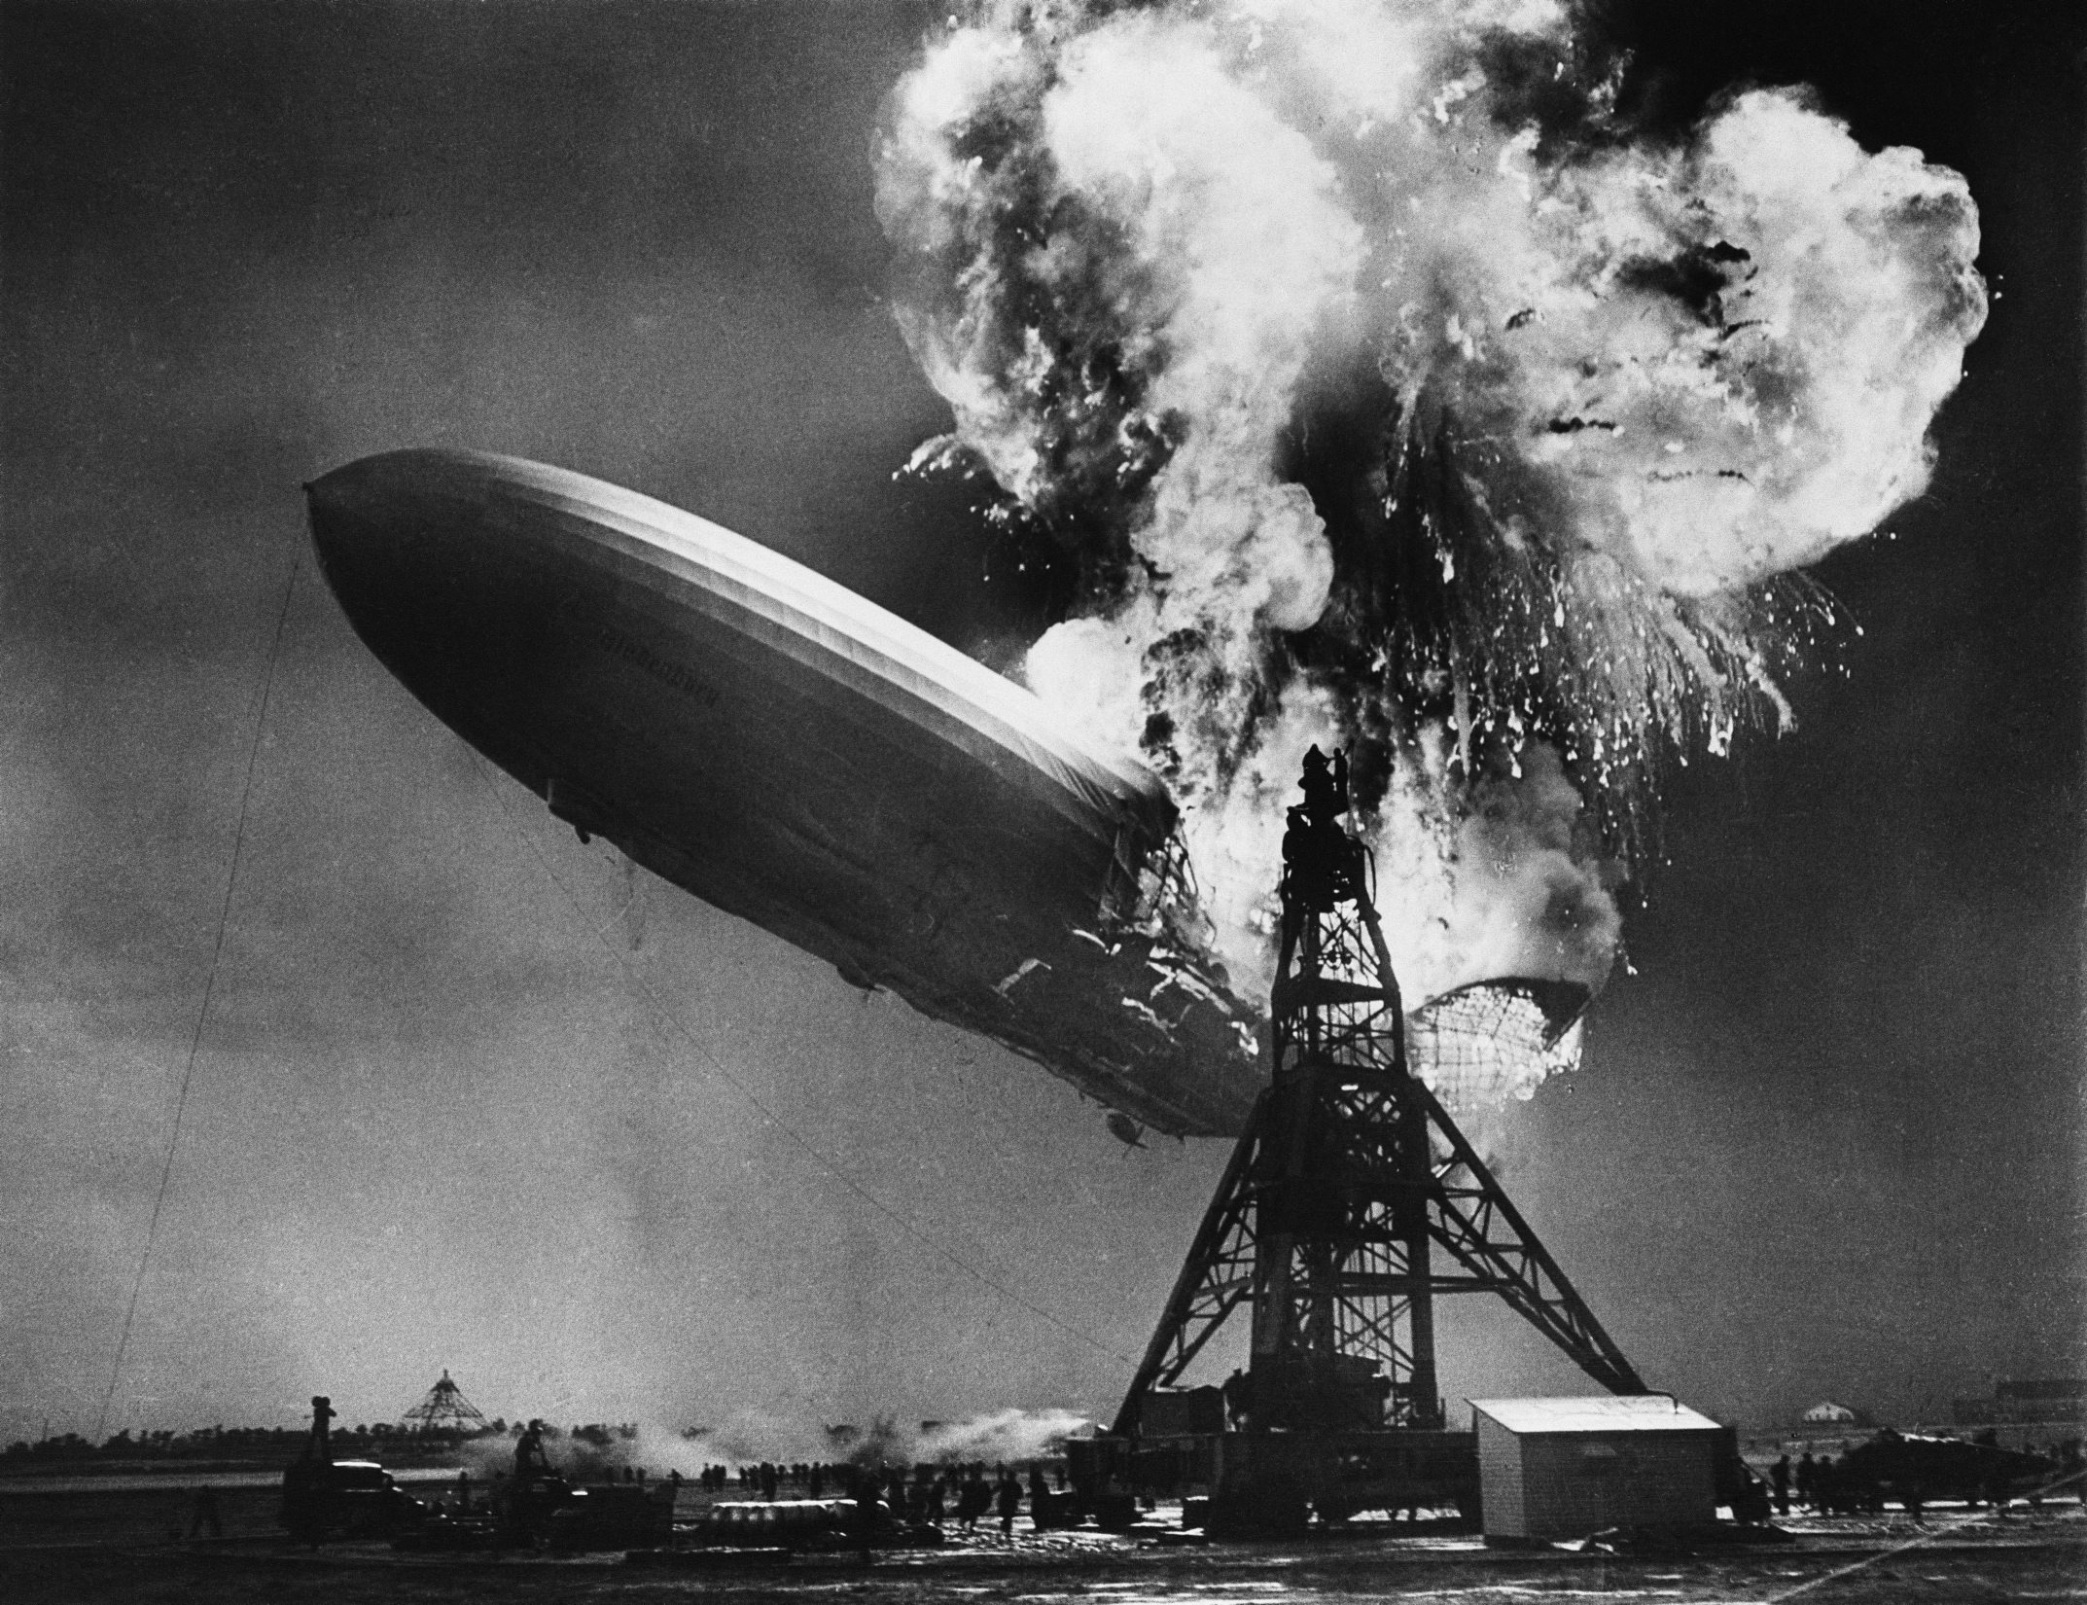

Slide 18
#3. Charles’s Law - 1787
The volume of a fixed mass of gas is directly proportional to the Kelvin temperature, when pressure is held constant.
Kelvin = C + 273 and C = Kelvin – 273
V and T are directly proportional
Notes:
Kelvin = C + 273
C = Kelvin - 273

Slide 19
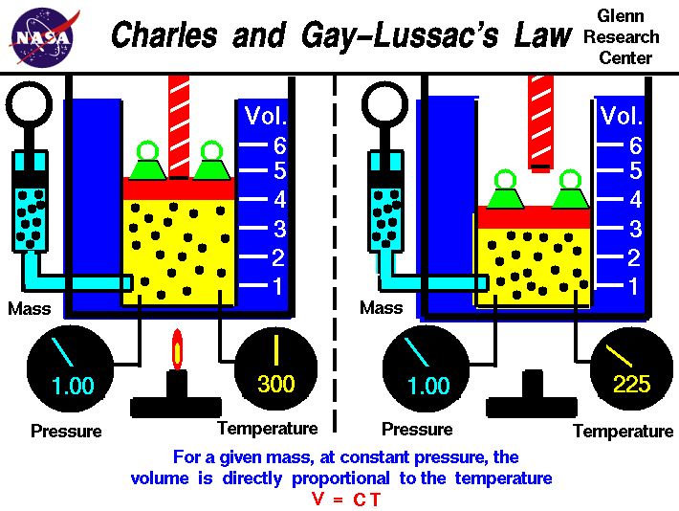
Charles’s Law

Slide 20
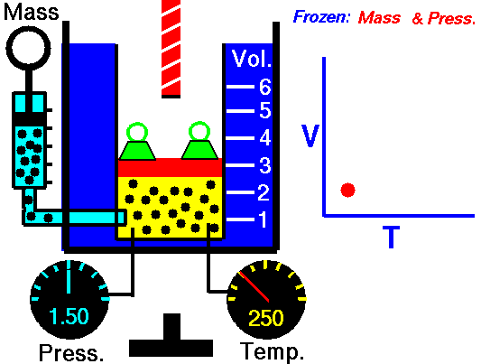
Charles’s Law
↑ temperature = ↑ volume (constant pressure)

Slide 21
Charles’s Law
V₁/T₁ = V₂/T₂ (temp must be in kelvin)
Example:
A balloon has a volume of 2.0 L at a temperature of 25ºC. What will the new volume be when the temperature drops to 10ºC?
V₁ =
T₁ =
V₂ =
T₂ =
V₁/T₁ = V₂/T₂
2.0 = V₂ 298 280
298 * V₂ = 2.0 * 280
V₂ = 2.0 * 280
298
2.0 L
25ºC + 273 = 298 K
V₂ = 1.9 L
1.9 L
10ºC + 273 = 280 K

Slide 22
Combined Gas Law
The combined gas law expresses the relationship between pressure, volume and temperature of a fixed amount of gas.
P₁ V₁ = P₂ V₂
T₁ T₂

Slide 23
Graphic Organizer
 | Boyle’s Law | Press-Temp Law | Charles’s Law
IN WORDS | With constant temp, V up = P down V down = P up | With constant volume, T up = P up T down=P down | With constant pressure, T up = V up T down=V down
IN NUMBERS | P1V1=P2V2 | P1 = P2 T1 T2 | V1=V2 T1 T2
Notes:
Boyle is the VP
Charles watches TV

Slide 24
Check for Understanding
Why does gas have pressure?
What is the pressure of Earth’s atmosphere at sea level?
Explain Boyle’s law. Give an example of Boyle’s law at work.
Explain Charles’s law. Give an example of Charles’s law at work.
Labels on cylinders of compressed gases state the highest temperature in which the cylinder may be exposed. Give a reason for this warning.
Notes:
Particles colliding
101.3 kPa (this means that at Earth’s surface, the atmosphere exerts a force of about 101,300 N on every square meter (about the weight of a large truck))
Decrease V ➔ Increase P EX: popping a balloon, deep sea divers if they don’t have pressure regulating suits…ouch. Increase V ➔ Decrease P EX: deep sea fish die when they reach surface (P decreases, so V increases)
Increase T ➔ Increase V EX: heat contained gas and it will explode, hot air balloon Decrease T ➔ Decrease V EX: leave a ball in the cold car and it will get flat
According to Charles’s law, if you increase the temperature of a confined gas, the volume will increase causing it to explode!

Slide 25
Practice
If a 5L balloon at 20◦C was gently heated to 30◦C, what new volume would the balloon have? (remember temp needs to be in K)
A balloon has a volume of 12.0L at a pressure of 101kPa. What will be the new volume when the pressure drops to 50kPa?
Notes:
C + 273 = K 5/293=V2/303 V2=5.2L
12(101)=50(V2) V2=24.2L

Slide 26
Until now, our # particles have remained constant. Introducing…. PV = nRT What are ideal gases? Do they exist?
4. The Ideal Gas Law

Slide 27
Ideal Gas Assumptions
Assumptions for ideal gases
Gases are made of molecules that are in constant, random motion.
Pressure is due to particle collisions with one another and the walls of their containers.
All collisions are perfectly elastic (no energy lost).

Slide 28
Ideal Gases
2 key assumptions of ideal gases
There is no attraction or repulsion between gas molecules.
Ideal gas particles have no volume
An ideal gas does not really exist, but it makes the math easier and is a close approximation.

Slide 29
Conditions where gases are CLOSE to ideal
Many gases behave close to “ideal” under:
High temps: particles move fast enough to make attraction/repulsion between particles negligible.
Low pressure: particles are very spread out so their volume is negligible to their container (they don’t take up space).

Slide 30
Equation: PV = nRT
Pressure times Volume equals the number of moles (n) times the Ideal Gas Constant (R) times the Temperature in Kelvin.
R = 8.314 (L x kPa) / (mol x K)
R = .0821 (L x atm) / (mol x K)
The other units must match the value of the constant, in order to cancel out.
The value of R could change, if other units of measurement are used for the other values (namely pressure changes)

Slide 31
Variables
P = pressure (kPa or atm)
V = volume (L)
n = moles
R = gas constant (8.314 L*kPa/mol*K), 0.0821 L*atm/mol*K)
T = temp (K)
Units must match!
Notes:
A mole of a substance is defined as:
The mass of substance containing the same number of fundamental units as there are atoms in exactly 12.000 g of ¹²C.
Fundamental units may be atoms, molecules, or formula units, depending on the substance concerned. At present, our best estimate of the number of atoms in 12.000 g of ¹²C is 6.022 x 10²³, a huge number of atoms. This is obviously a very important quantity. For historical reasons, it is called Avogadro's Number, and is given the symbol N_{A}.

Slide 32
MOLE
A mole of a substance is defined as: The mass of substance containing the same number of fundamental units as there are atoms in exactly 12.000 g of ¹²C.
Fundamental units may be atoms, molecules, or formula units, depending on the substance concerned. At present, our best estimate of the number of atoms in 12.000 g of ¹²C is 6.022 x 10²³, a huge number of atoms. This is obviously a very important quantity. For historical reasons, it is called Avogadro's Number, and is given the symbol N_{A}.

Slide 33
Moles
n = moles
A mole is the amount of substance in a given mass of substance.
n = mass (g)/ molar mass
Molar mass = mass of atoms in an element or compound.
Ex. H₂0
H = 1.008g O = 16g
1.008(2) + 16 = 18.02 g/mol
Notes:
Why do we use moles?
It allows the chemist to weigh out amounts of two substances, say iron and sulfur, such that equal numbers of atoms of iron and sulfur are obtained. A mole of a substance is defined as: The mass of substance containing the same number of fundamental units as there are atoms in exactly 12.000 g of ¹²C.

Slide 34
Moles
Ex. How many moles are in 50.0 g of oxygen gas?
n = mass(g)/Molar mass
n = 50g/32g
n = 1.56 mol

Slide 35
R
Gas constant, determined experimentally
.0821 L*atm/mol*K if pressure is in atm
8.31 L*kPa/mol*K if pressure is in kPa
BTW…
1 atmosphere = 101.3 kPa = 14.7 lbs/in² = 760mmHg
How many kPa in 3 atm? (BFF)

Slide 36
Example:
If I contain 2.1 moles of gas in a container with a volume of 62.0 L and a temperature of 157.3 C, what is the pressure inside that container?
P = ? T = 157.3 C
V = 62.0L R = 8.314 L*kPa/(mol*K)
or
N = 2.1 moles R = 0.0821 L*atm/(mol*K)

Slide 37
How does my pressure and my temperature affect my Phase????
When we talk about the melting and pointing point of water at 0C and 100C we are assuming we are at approximately sea level where we have an atmospheric pressure of 1atm
When you go up to the mountains you are at a higher elevation and at a lower atmospheric pressure. Because of this, your water will boil at lower temperature.
If I could drill a deep hole a mile into the Earth, my boiling point would increase
Notes:
In the mountains, there are fewer air particles pushing down on you which means the atmospheric pressure is lower. If pressure is lower, then the boiling point decreases

Slide 38
Phase Changes Revisited

Slide 39
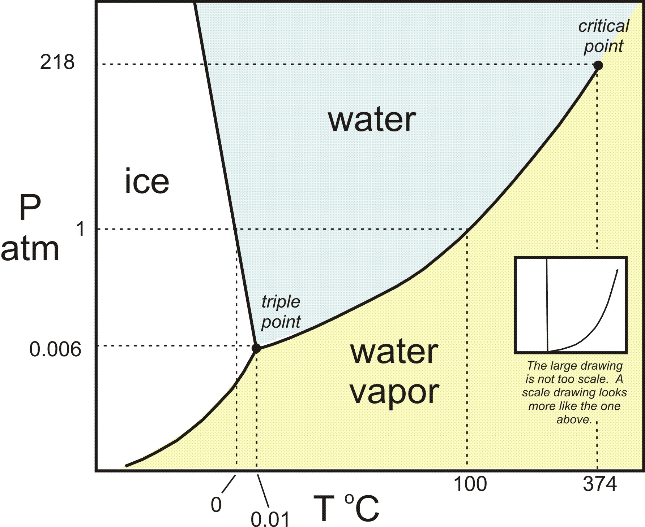
Notes:
At 1 atm, water melts at 0C and boils at 100C.
Pressure cooker – increases the pressure to about 12 atm (in electric cookers) so my BP increases. So it increase the temp w/o changing the state of matter so it cooks my food faster.
Triple point - the temperature and pressure at which the solid, liquid, and vapor phases of a pure substance can coexist in equilibrium.
Critical point - a point on a phase diagram at which both the liquid and gas phases of a substance have the same density, and are therefore indistinguishable.
ALL OF THIS TO SAY THAT PRESSURE AND TEMPERATURE DETERMINE THE PHASE! ☺

Slide 40
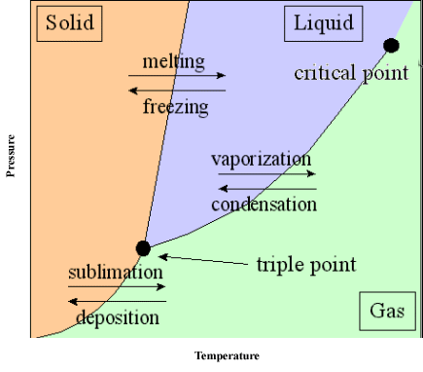

Slide 41
Energy during a Phase Change
How can I calculate how much heat energy I need for a phase change?
We know how to calculate how much heat energy we need to increase our kinetic energy of our matter using our specific heat calculation
Q = mCΔT
When we are changing phases the heat energy we are adding is in terms of POTENTIAL energy which goes into weakening the IMA’s and allowing the particles to be FURTHER from each other
Notes:
EX: Q = 156 g x 4.184 x 5*C (E needed to raise the temp of water)
During a phase change, our temp doesn’t change…so we won’t use temperature!
Q = mL

Slide 42
How to Calculate Latent Heat
There is no change in temperature so no change in KE, just an increase in PE as the particles are allowed to move further from each other. (remember from 1st semester? Higher PE means more distance between particles)
Heat of Fusion - Amount of heat needed to change from a solid to a liquid (or amount of heat lost to go from a liquid to a solid)
Heat of Vaporization - Amount of heat needed to change from a liquid to a gas (or amount of heat lost to go from a gas to a liquid)

Slide 43
Latent Heat Calculation
Q = mL
Q = heat energy (J)
m = mass (g)
L = Latent Heat Value (J/g)

