Slide 1
Geologic Time!!
Ch 12.4-13.4

Slide 2
Geologic Time Scale: an outline of the geologic events and development of life on Earth.
It includes: geologic events and major developments in the evolution of life.

Slide 3
Geologic Column – For Your Info!
*No single area on earth contains a record of all geologic time!
*Observations were combined to make a timeline of Earth’s history, with the oldest layers on the bottom and most recent at the top.
*How did scientists know which order to put them in?
*Similar fossils *Same relative position *Average rate of erosion *Radiometric dating

Slide 4
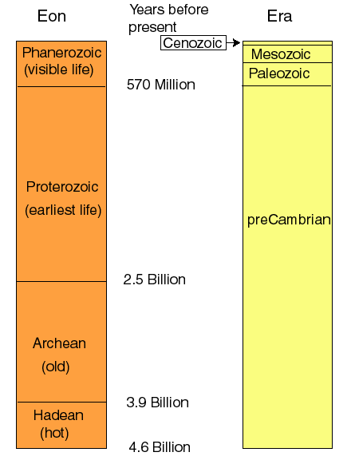
Divisions of Geologic Time
*divided by major changes in Earth’s surface, climate, and the types of organisms.
There are 4 major divisions of time:
*Eon: Very long unit of time. 3 eons are combined to show Precambrian Time
*Era: a large unit of geologic time.
*Period: Separated by specific fossils, named by where fossils were found.
*Epoch: Shortest division. Lots of detailed fossils. Only in the Cenozoic Era!

Slide 5
What happened in the first 3 eons?
Earth formed
The atmosphere and oceans developed
Early life evolved
*This took about 4 billion years!

Slide 6
What is another name for the first 3 eons?
Precambrian Time
Are there a lot of rocks left from the Precambrian Time? Why or why not?
No. Most of the rocks have been deformed by erosion or metamorphosis.

Slide 7
Why does the Phanerozoic eon have so many more fossils?
More types of life and rocks haven’t been destroyed as much.

Slide 8
What are the names of the 3 era and what do the names mean?
Paleozoic – “Ancient Life”
Mesozoic – “Middle Life”
Cenozoic – “Recent Life”

Slide 9
How are the periods named?
By the types of fossils found or where they were located.
Hypothesize about why only the Cenozoic era is broken down into epochs.
Lots more fossils because rocks haven’t been destroyed; more organisms to leave fossils.

Slide 10
Precambrian Time
*Much longer than other geologic eras
*Few fossils exist, so can’t divide into smaller groups
*Most organisms too soft to leave fossils.
*Much of the rock is too deformed to see order of age
*Large areas of exposed rock called shields exist on every continent.
*Examples of organisms:
Stromatolites
Marine worms
Jellyfish
Single-celled organisms
*This leads scientists to believe that life began in the oceans.

Slide 11
Paleozoic Era
*Name means “Ancient Life”
*Pangaea formed by end of era.
*Many more fossils, and of plants and animals
Examples of organisms:
Trilobites
Brachiopods
Fish
Amphibians
*Mass extinction marked the end of the Paleozoic Era. A mass extinction of life occurred.

Slide 12
Mesozoic Era
*Name means “Middle Life”
*Pangaea began to break up, and mountain ranges developed.
*Examples:
Reptiles/Dinosaurs Ammonites
Birds
Flowering Plants
*Called “Age of Reptiles”.
*Mass extinction: marked the end of the Mesozoic Era. There was a mass extinction of all dinosaurs and many marine animals.

Slide 13
Cenozoic Time
*Name means “Recent Life”
*More and more complex organisms.
*Many extreme climate changes (Ice Age).
*Continents were almost in their current position
*More mountain ranges formed.
*Many more mammals than any other era.
*Examples:
Primates
Horses
Carnivores
Mammoths
Humans
*We are still in this era!

Slide 14
What patterns do we see?
Organisms get more and more complex.
More fossils exist from the later eras.
(SKETCH THIS PICTURE!)

