Slide 1
Quick Chat: Air Pressure
http://kids.earth.nasa.gov/archive/air_pressure/

Slide 2
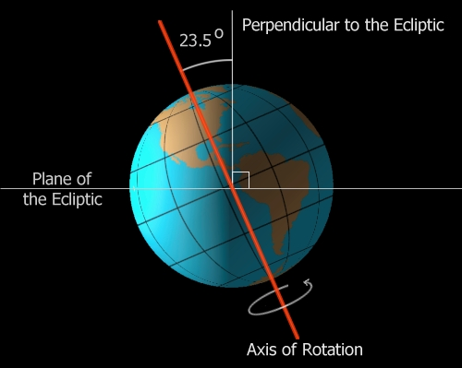
Weather: Ch 17, 19, 20, 21
Why do we have seasons?
Seasons happen because the Earth is tilted. This causes areas to receive different amounts of the Sun’s energy.

Slide 3
Ch 17.2: Heating the Atmosphere - pg 483 Why is heat transferred?
Because energy moves due to a difference in temperatures.
What is temperature?
The measure of kinetic (moving) energy in particles.
Higher temps = faster moving particles

Slide 4
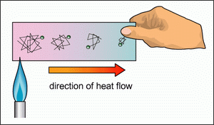
Conduction
Transfer of heat by touching
Best in solids
Particles bump into each other, transferring their energy
Heat flows from high to low temps

Slide 5
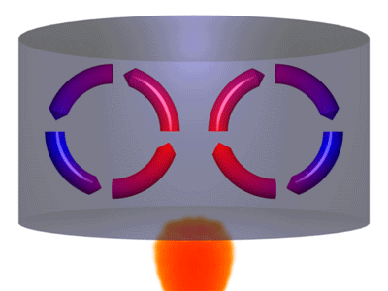
Convection
Heat transfer by circulation in fluids
Best in liquids and gases because particles are free to move around.
Examples: Earth’s asthenosphere, oceans, atmosphere

Slide 6
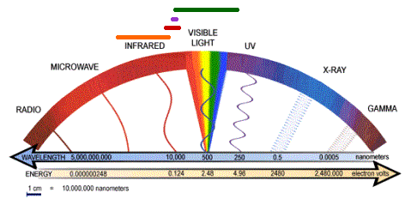
Radiation
Heat transferred by waves
Do not need material to move through
This is how the sun’s energy can travel through space!
All objects give off some radiation
Short waves = hotter temps
Objects that absorb radiation also give off radiation

Slide 7
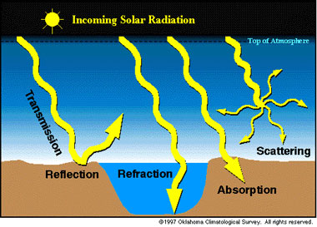
What can happen to solar radiation?
Reflected: waves bounce off of an object; all the energy just changes direction.
Scattered: waves hit a dust or gas particle and are spread out; why we have blue skies and see red sunsets
Absorbed: about 50% of radiation is absorbed; water vapor and CO₂ are best at this (greenhouse effect)

Slide 8
Ch 17.3: Temperature Controls – pg 488 Why do temperatures vary?
Latitude
Heating of land and water
Altitude
Geographic position
Cloud cover
Ocean currents

Slide 9
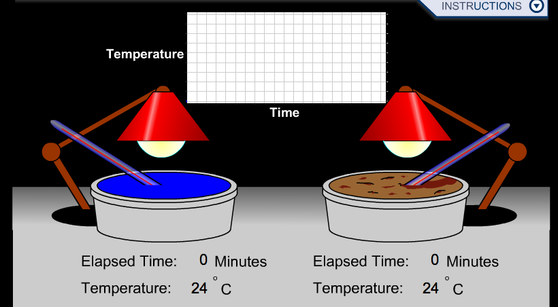
Land vs Water
Land heats and cools more quickly than water, so temperatures show more variation.

Slide 10
Land and Water
The ocean moderates Vancouver’s climate, so temps do not vary as much (marine)
Winnipeg experiences much greater variation in temps because it is far away from the ocean (continental)

Slide 11
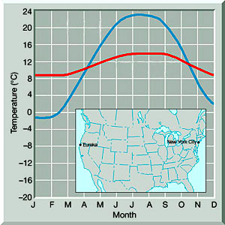
Geographic position: West vs. East Coasts
If winds blow from the ocean to the land, temps do not change very much (windward coast)
If winds blow from land toward the ocean, there is more variation (leeward coast)

Slide 12
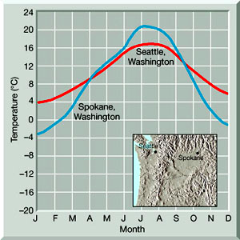
Geographic position: Mountains as barriers
Mountains can also affect temps
Seattle has a marine influence
Spokane is more continental
Cascade Mtns cut off Spokane from the moderating influence of the Pacific Ocean

Slide 13
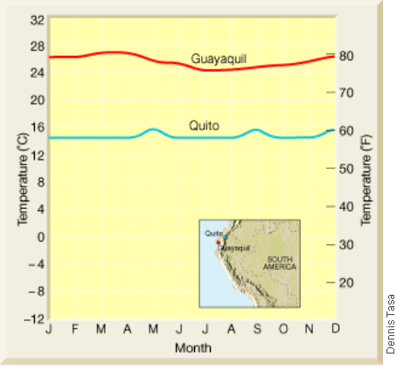
Altitude
How high a place is located can impact its temperatures, even if they are close to each other. (Mountain vs. flat land)

Slide 14
What is albedo?
Albedo is the total radiation reflected by a surface.
High Albedo: clouds, snow, deserts
Low Albedo: soil, most types of land
What are isotherms?
Iso = equal
Therm = heat
Isotherms are lines that connect points of the same temperature.

Slide 15
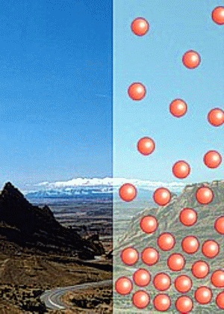
Ch 19.1: Understanding Air Presure – pg 532
The weight of the air pushing down the surface of an object.
Average = 1 kilogram per square centimeter (1 kg/cm²)
Air pressure pushes in ALL directions!
Measure using barometer

Slide 16
What causes winds?
Horizontal difference in air pressure.
Moves from HIGH to LOW pressure
The differences occur because of uneven solar radiation amounts.
Low pressure – warm, less dense air
High pressure – cool, more dense air

Slide 17
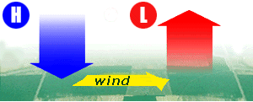
3 Factors that control wind
Pressure differences:
-the bigger the difference, the stronger the wind; this is the pressure gradient.

Slide 18
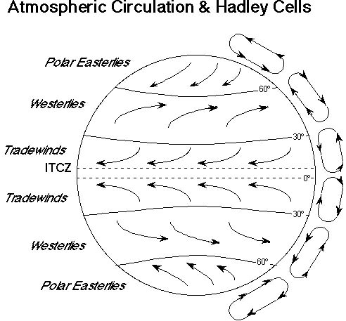
3 Factors that control wind
Coriolis Effect:
-Winds are deflected (bent) to the right in the northern hemisphere due to Earth’s rotation; only affects direction, not speed

Slide 19
3 Factors that control wind
Friction:
-Rough surfaces slow winds down and make them travel at different angles due to friction.
**Jet Stream: fast moving wind at the top of the troposphere; not affected by friction

Slide 20
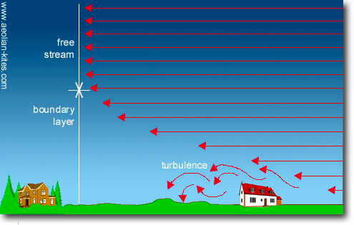

Slide 21
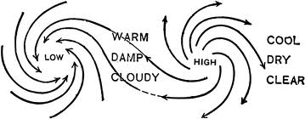
Ch 19.2: Pressure Centers & Winds – pg 537 Low Pressure vs High Pressure
Low pressure - pressure decreases as you move to the center
High pressure - pressure increases as you move to the center

Slide 22
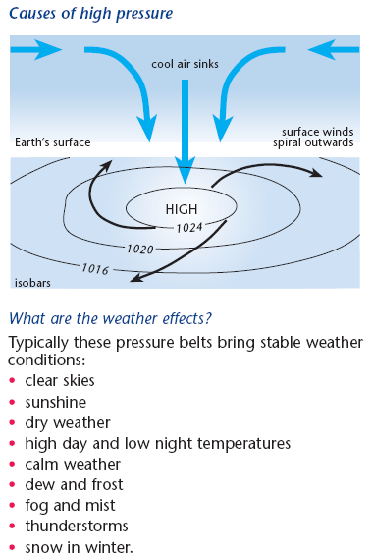
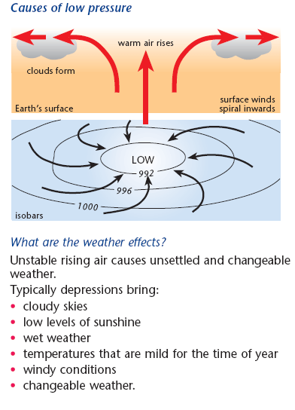

Slide 23
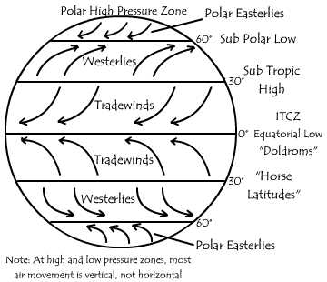
Global Winds

Slide 24
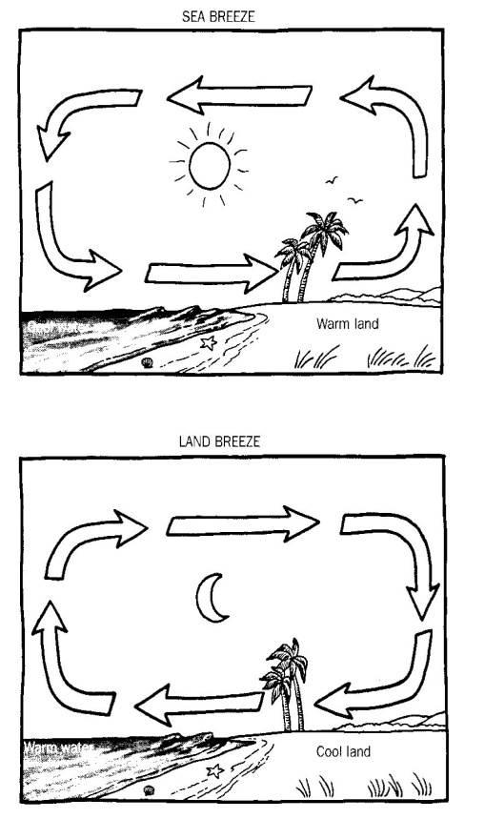
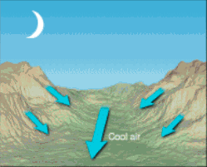
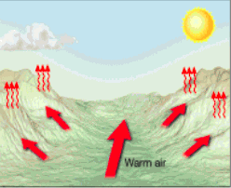
Ch 19.3: Regional Wind Systems – pg 543
Mountain Breeze
Valley Breeze
Notes:
Sea Breeze – air over land heats, expands, and rises creating area of low pressure so a sea breeze develops bec as warm air rises, cool sea air replaces it
Land Breeze – night time, air over land cools more rapidly and creates an area of high pressure
Mountain Breeze (top) – air cools and sinks
Valley Breeze (bottom) – air warms and sinks

Slide 25
Land and Sea Breeze Animation
http://www.classzone.com/books/earth_science/terc/content/visualizations/es1903/es1903page01.cfm

Slide 26
How are winds named?
By the direction they come FROM
EX: Westerlies come from the west
EX: Easterlies come from the east
Prevailing winds occur when the wind blows from 1 direction most of the time.
Anemometers measure wind speed.

Slide 27
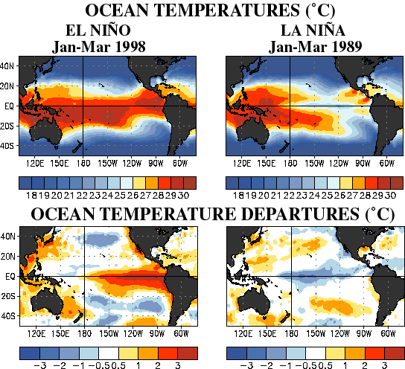
El Nino vs. La Nina
El Nino: warm water replaces where there is usually cool water. Happens every 3-7 years
The warm weather makes it hard for marine life.
La Nina: even cooler water comes in, bringing colder temperatures; can cause more hurricanes.

Slide 28
Ch 20.1: Air Masses – pg 558
Air mass - Large body of air that has similar temperatures and moisture levels.
How do air masses move?
As air masses move, they change (temp and moisture) and also change the weather of an area.

Slide 29
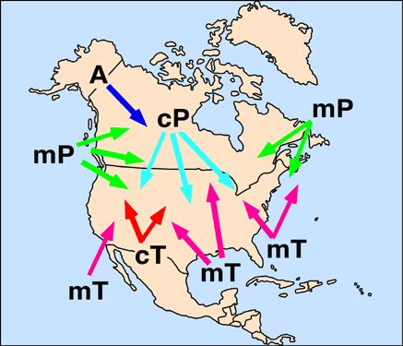
Air masses

Slide 30
cP: Continental Polar -cold and dry in winter - cool and dry in summer -usually no precip
mT: Maritime Tropical -warm, lots of moisture -unstable

Slide 31
mP: Maritime Polar -mild, moist air -unstable -carries lots of precip
cT: Continental Tropical -can cause extremely hot, dry conditions
Thunderstorms = mT + cP

Slide 32
Ch 20.2: Fronts – pg 564 How do fronts form?
Two air masses meet creating a boundary.

Slide 33
Types of Fronts
Warm Fronts
Cold Fronts
Warm air glides over a cool air mass.
Warmer temps and light precip.
Move slowly
Cold air forces up warm air
Colder temps, violent storms, and strong winds
Moves VERY quickly

Slide 34
Types of Fronts
Stationary Fronts
Occluded Fronts
Warm meets cool, but neither moves.
Sometime have light precipitation
Fast moving cold air pushes through warm air.
Complex weather

Slide 35
Ch 21.1, 3: Factors Affecting Climate
Latitude – as latitude increases, the average intensity of solar energy decreases
Elevation – the higher the elevation, the colder the climate
Topography – mountains affect amount of precipitation

Slide 36
Ch 21.1, 3: Factors Affecting Climate
Bodies of water – temp of water influences the temp of the air above it
Global Winds – distribute heat and moisture around the Earth
Vegetation – affects temp and precip by energy absorption /release and transpiration

Slide 37
Ch 21.1, 3: Factors Affecting Climate
Plate tectonics – changes climate over long periods of time
Earth’s orbit – intervals, long periods of time
Ocean circulation – El Nino causes parts of the ocean to become warmer than usual

Slide 38
Ch 21.1, 3: Factors Affecting Climate
Solar activity – increase in sunspots can cause warm periods
Volcanic eruptions – ash and dust cause cooler temps over short term, and warmer temps over long term
Greenhouse effect – natural warming of Earth’s atmosphere and surface
Global warming – global temps increasing from increased carbon dioxide levels in atmosphere

