Slide 1
Forces
Chapter 12.1-4

Slide 2
What is a force?
A force is a push or pull that one body exerts on another.
  Examples: kicking a soccer ball, pushing a chair, gravity
  Brain Pop: Forces

Slide 3
How does a force change motion?
Net force: the combination of 2 or more forces acting on an object.

Slide 4

Balanced Forces
Forces are equal in size and opposite in direction.
Net Force = 0

Slide 5
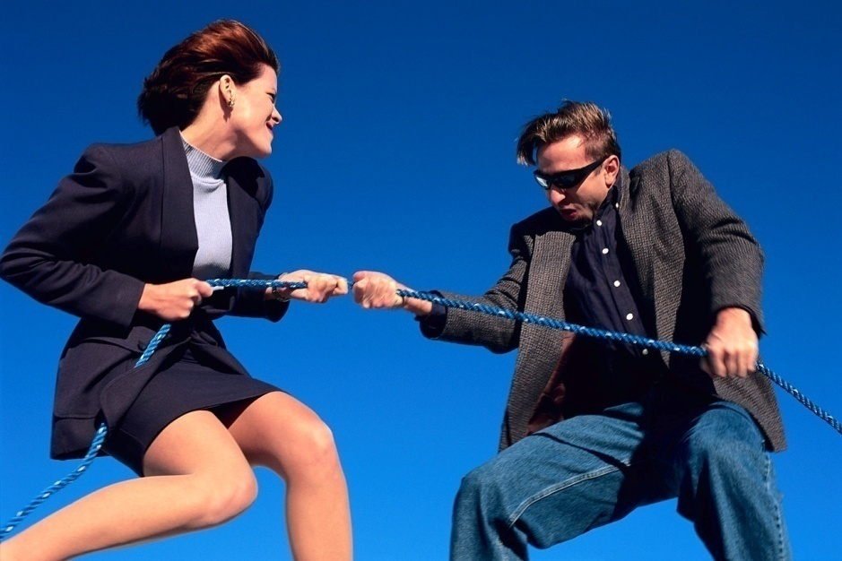
Unbalanced Forces
Unequal forces from opposite directions cause an object to move in a certain direction.
Forces in the same direction combine to create an unbalanced net force.

Slide 6

What is friction?
The force that opposes motion between two surfaces that are touching each other.
What causes friction?
Nearly all surfaces are rough at the microscopic level. The highest bumps (microwelds) stick together, so a higher force is needed to move the object.

Slide 7
Types of Friction
Static
The friction between 2 surfaces that are not moving past each other.
Applied force = friction
Sliding
Microwelds break and reform when a force is applied. A constant force is needed to make the box slide.
Applied force > friction
Rolling
The friction between a rolling object and the surface it rolls on.
Takes less force to start.
Easier to use a wagon than push on the ground.

Slide 8
More Friction…
Air resistance
  Affects anything that moves in Earth’s atmosphere
  Air resistance is a force that opposes gravity
    Always acts in the opposite direction of motion, too
  When an object falls, it is pulled downward by gravity
  Gravity causes objects to accelerate downward
    Air resistance slows down this acceleration
    When the force of air resistance equals gravity, the object does not speed up anymore (= balanced forces)
      This is called terminal velocity
  Amount depends on 1) speed, 2) size and 3) shape of object

Slide 9
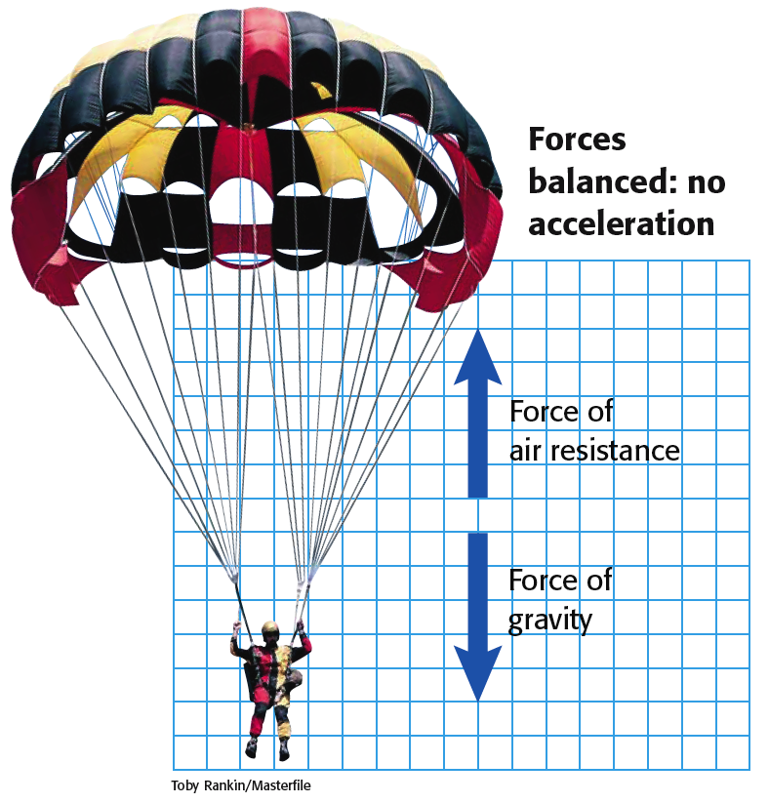
Terminal Velocity
Vimeo: Base Jumping Video
Notes:
Background knowledge: terminal velocity occurs when the downward force of gravity equals the upward force of air resistance. At this point, the object (or person) cannot travel any faster. When a skydiver opens the parachute, air resistance increases because of surface area. Air resistance also increases as the person picks up speed (they encounter more air particles). As soon as the air resistance is high enough to equal the downward force of gravity, the skydiver can no longer increase their speed and is said to have reached terminal velocity. The sooner the skydiver reaches terminal velocity, the sooner they will stop accelerating and the “slower” their maximum velocity will be.

Slide 10
Without Air Resistance?
What occurs if 2 very different items are dropped in a vacuum (no air)?

Slide 11
Gravity, con’t
Free Fall and Weight
  When gravity is the only force acting on an object, the object is in free fall - Feather vs. Hammer
  Glencoe Gravity Interactive
    It is abbreviated by the letter g and is equal to 9.8 m/s²
  The force on an object due to gravity is called its weight
    On Earth, your weight is then just the amount of gravitational force exerted on you by Earth
      You can manipulate Newton’s Second Law to get an equation for weight
        Force = weight; mass is still mass; acceleration = g
        weight = mass x acceleration or w = mg

Slide 12
Gravity, con’t
Inertia and Gravity
  Suppose you were to drop a bowling ball and a marble from a bridge at the same time. Which would hit the water below first?
  The force of gravity would be greater on the bowling ball because of its larger mass, but it also has more inertia (resistance to a change in motion).
  The force of gravity would be less on the marble because of its smaller mass, but it also has less inertia.

Slide 13
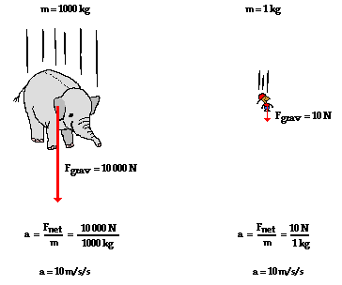
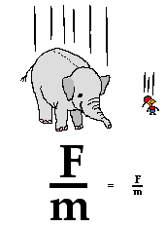
Another example:
The proportions are the same.

Slide 14
Why do astronauts feel weightless when orbiting Earth, even though about 90% of gravity is present?
In orbit, the shuttle and people are falling toward Earth at the same rate, like you in an elevator. There is no force supporting them.
Weightlessness in space
When would astronauts be truly weightless?
Guest Speaker: Can we experience weightlessness?

Slide 15
Projectile Motion
  Curved path an object follows when thrown, launched or otherwise projected near the surface of Earth
  Has two components:
    Horizontal
      Motion that is perpendicular to Earth’s gravitational field
      Once initial force is applied, object travels at constant [horizontal] velocity
    Vertical
      When an object is released, force of gravity pulls it downward
    You should always aim above a target due to vertical component of gravity

Slide 16
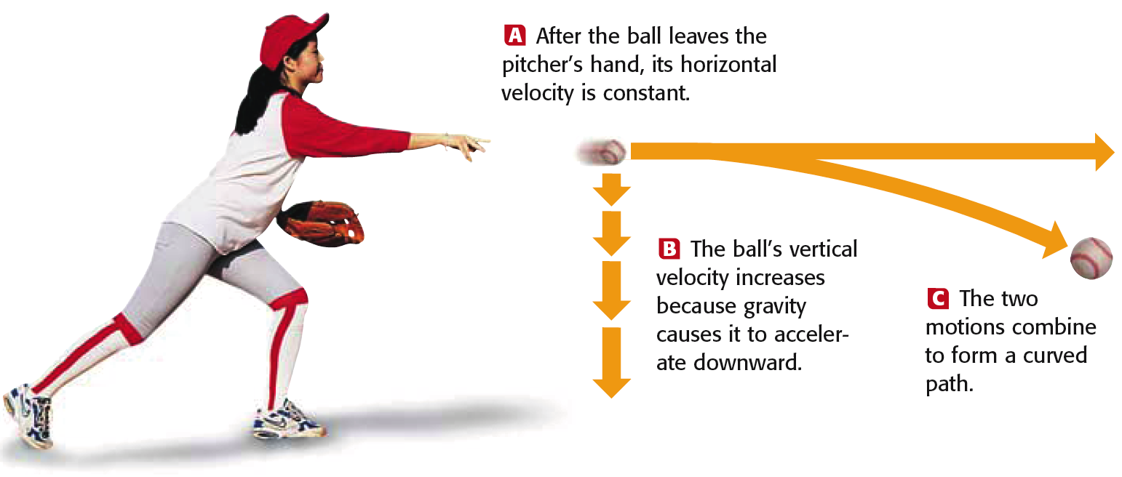
Projectile Motion

Slide 17
Projectile Motion in Action!
Monkey Problem

Slide 18
Newton’s Laws
How can I be remembered forever? I know!! I’ll define 3 laws of Physics!!

Slide 19
Newton’s First Law of Motion
Official: An object moving at a constant velocity keeps moving at a constant velocity unless an unbalanced force acts on it.
Simple: An object moving, keeps moving. An object resting, keeps resting.

Slide 20
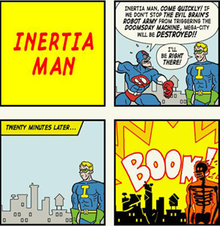
What is inertia?
An object tends to move on a path at the same speed unless an unbalanced force works on it.

Slide 21
Why is a seatbelt important?
In a crash, our body wants to keep moving forward.
Unbelted people smash into the steering wheel, dashboard, or windshield at the speed the car was moving.
Seatbelts prevent that from occurring.
Crash Testing Females

Slide 22
How are force and acceleration connected?
For any object, the greater the force applied, the greater the acceleration will be.
↑ Force = ↑ acceleration

Slide 23
How are force and mass connected?
If an object has a greater mass, it takes a greater force to increase the acceleration.
↑ Mass = ↑ force to accelerate

Slide 24
My Second Law..
The unbalanced force acting on an object causes the object to accelerate in the direction of the unbalanced force.
Simple: An object moves in the direction it is pushed or pulled.
Calculate using: force, mass, and acceleration!

Slide 25

F
F
m
a
m
A
F = m * a
m = F/a
a = F/m
Recite Time

Slide 26
Mara is pushing a 100kg baby elephant with a F of 50N. What is the accel of the elephant?

Slide 27
A 520kg dog is accel at a rate of
.5m/s². What is the force that caused this accel?

Slide 28
A rhino is pushing Sabrina with a force of 45N. Sabrina accel at a rate of .5m/s2. What is the mass of Sabrina?
She lives…dun dun duh!

Slide 31
Why is your weight different on other planets or the moon?
Weight and mass are NOT the same. Planets and moons have different masses, so they have different gravitational forces.
Moon’s gravity = 1/6 of Earth’s gravity. Weight on moon < weight on Earth, mass stays the same.

Slide 32
Gravity
Law of Universal Gravitation
  States that all objects in the universe exert an attractive force on each other
  Depends on 1) mass of the two objects and 2) distance between the two objects
  Equation
    The gravitational force increases as one or both masses increase
    The gravitational force decreases as the distance between the masses increases
  m₁ and m₂ are the masses of the two objects
  d is the distance between the two objects
  G is a constant

Slide 33
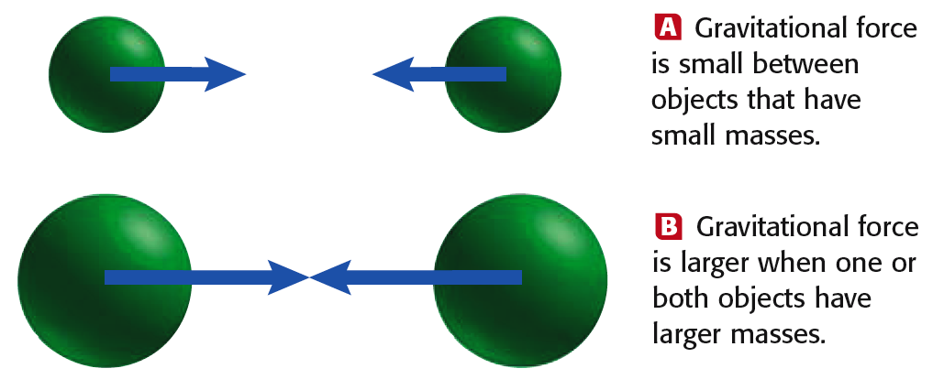
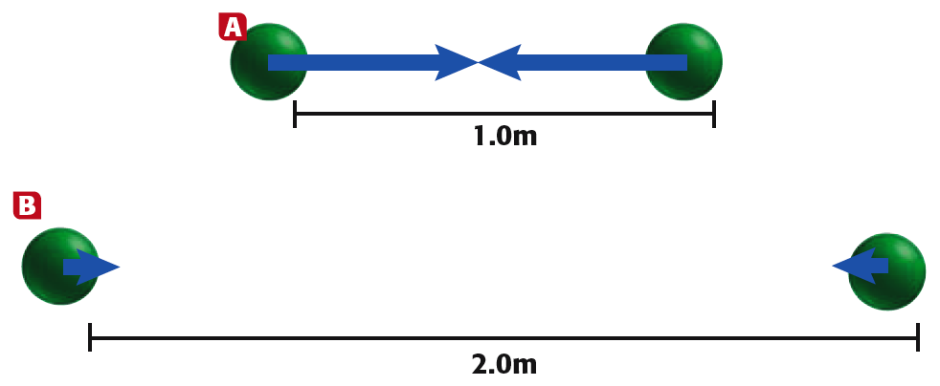
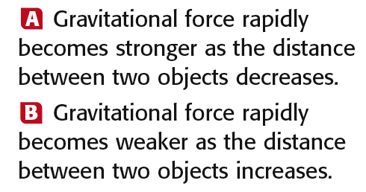
Law of Universal Gravitation

Slide 34
My Third Law..
When one object exerts a force on a second object, the second one exerts a force on the first that is equal in size and opposite in direction.
Simple: For every action, there is an equal and opposite reaction.

Slide 35
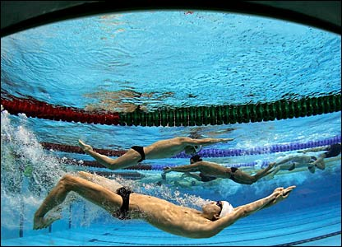
Newton’s Third Law of Motion
So how do we move if the forces are equal and opposite?
  The action-reaction forces are acting on different objects.
  Just because the forces are equal does not mean they are balanced!
  Science of NFL Football-Newton’s Third Law

Slide 36
Momentum = Mass in Motion
Momentum
  A property of all moving objects that describes how much force is needed to change its motion
    A product of mass and velocity
    momentum = mass × velocity OR p = mv
      The larger the mass, the greater the momentum
      The larger the velocity, the greater the momentum
  Has a direction in the same direction as the velocity
  Force is related to change in momentum
    As the time period of the momentum’s change becomes longer, the force needed to cause this change in momentum becomes smaller

Slide 37
Force, Changing Momentum, and Impulse
F = (mv_{f} – mv_{i}) / t
The net force of an object can be found by calculating the change in momentum and dividing it by the amount of time.
Impulse = F x t = (mv_{f} – mv_{i}) / t
EX: Egg drop, seatbelt
Notes:
Assume that, you push a box with a force of 10N for 2 seconds, the impulse is 20N.s. Then you push it with a 5N force for 4 seconds and impulse does not change. As you see increasing the time decreases the amount of force. Thus, the unwanted results of force can be eliminated by increasing the time of force application. On the contrary if you want big force then you should decrease the time and you get big force.
IMPULSE STAYS THE SAME, BUT THE FORCE CHANGES WITH THE TIME

Slide 38
Newton’s Third Law, con’t
Momentum continued
  Law of Conservation of Momentum
    The total amount of momentum in an isolated system is conserved
      When a moving object hits a second object, some or all of the momentum of the first object is transferred to the second object
    See Figure in textbook (elastic and inelastic collisions)

Slide 39
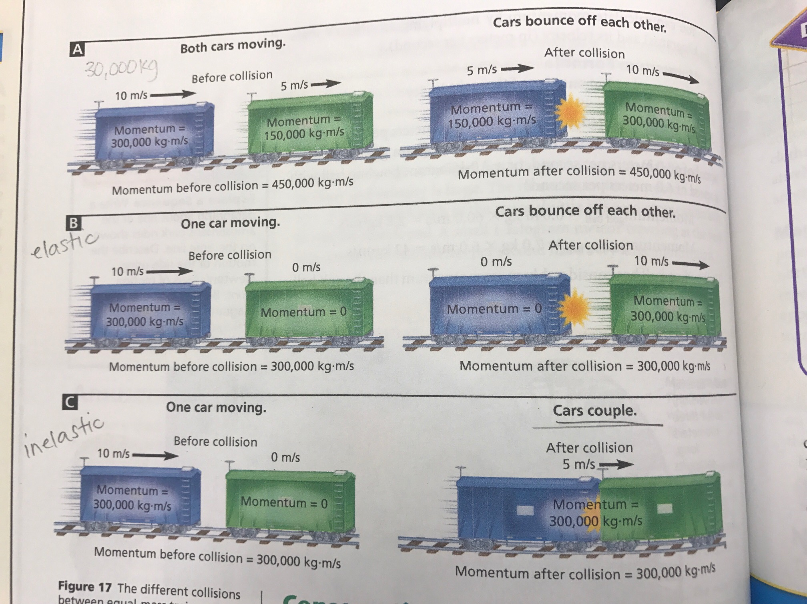

Slide 40
Inertia vs. Momentum
Inertia – physical property based solely on mass
Momentum – vector quantity that describes how matter acts when it is in motion; it is conserved and can be calculated p = mv
Read more: http://www.ehow.com/info_8119514_differences-between-momentum-inertia.html#ixzz2fIjhyPJu

