Slide 1
Chapter 6: Chemical Bonds
When the highest occupied energy level of an atom is filled with e, the atom is stable and not likely to react.
In other words, all stable elements have 8 electrons in the outer level.
What determines the chemical properties of an atom?
How do we know the number of valence electrons an atom has?
Why do atoms bond?
Are there different ways atoms can bond?

Slide 2
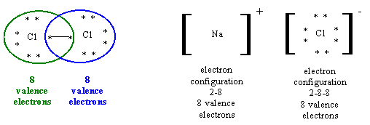
Combining Elements
Combining elements usually changes their properties.
EX: Sodium (explosive) mixed with chlorine (poisonous gas) = table salt (NaCl)
Sometimes electrons are shared, sometimes they are transferred.
Goal: have 8 electrons in the outer level.

Slide 3
Do two metals bond?
Yes, in a different sort of way…
Sometimes called a transient ionic bond.
Think of it as playing hot potato with electrons…
Or a merry-go-round with 15 people on, but the only way you can stay on is to hold onto a stick…but there are 12 sticks…BETTER PASS FAST!!

Slide 4
Ch. 6.1: Ionic Bonding
Electron dot diagram – model of an atom in which each dot represents a valence electron
Some elements become stable by transferring electrons between atoms.
Anion – negative ion
(named by adding –ide, ex: chloride ion)
Cation – positive ion
(name is element name, ex: sodium ion)

Slide 5
How to draw an Electron Dot Diagram
Find element on table.
Write symbol.
Look at the group number to determine the number of dots.
Draw dots.
HUND Rule: Every orbital in a subshell is singly occupied w/1 electron before any one orbital is doubly occupied…
Notes:
THIS SLIDE IS NOT ONLINE…
End here 1/8
Then direct to periodic table review…
Periodic Table basics…

Slide 6
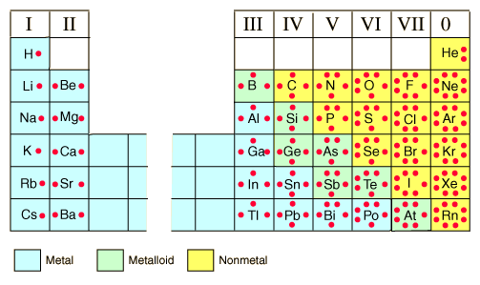
Electron Dot Diagrams
Notes:
Aka lewis dot structure
Write steps explaining how to draw a Lewis Dot Structure.

Slide 7
Ionic Bonds
Bonds where electrons are transferred.
Some atoms have an electron to give away; hydrogen, sodium (Na), lithium (Li)
(think about Lewis dot diagrams)
Some atoms want to gain electrons; chlorine (Cl), iodine (I); oxygen (O)
There should always be a zero net charge.
Usually metals with nonmetals.
One atom loses an electron while the other gains one. Then the opposite charges attract one another.
Ionic compounds are usually crystalline solids with high melting points

Slide 8
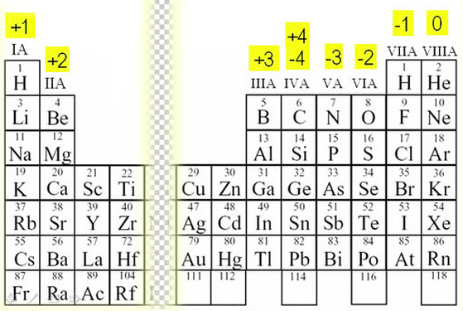
One more trend…
Oxidation state – hypothetical charge an element would have if it bonded

Slide 9
Practice
Draw the electron dot diagrams and the ionic bond for the following pairs:
Ca and Br
K and O
How many atoms of each element in this chemical formula? RaCl₂

Slide 10
Ch. 6.2: Covalent Bonds
Nonmetals have high ionization energies, which means what? So how do they bond?
Electrons are shared between 2 or more atoms; creates a molecule.
Can be diatomic molecules (super 7)
EX: F₂, N₂, O₂, H₂, Br₂, I₂, Cl₂
Can have multiple covalent bonds
EX: Double bonds, triple bonds
Notes:
END HERE…review polarity

Slide 11
Covalent, cont.

Slide 12
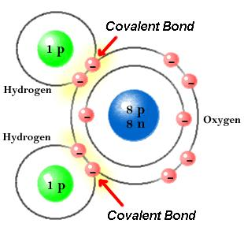
Covalent Bonds, continued.
Sometimes the tug-of-war causes the molecule to be polar.
Has one more negative end and one more positive end.

Slide 13
Practice
Draw the electron dot diagrams and the ionic bond for the following pairs:
H and Br
C and H
How many atoms of each element in this chemical formula? C₆H₁₂O₆

Slide 14
Ionic or Covalent: How to know?
Look at element type AND the electronegativity differences
Measure of attraction for electrons
Non-polar Covalent Bonds: equal or near-equal sharing of electrons (EN difference is between 0.0-0.4
Polar Covalent Bonds: unequal sharing of electrons (EN difference is between 0.5-1.7)
Ionic Bond: complete transfer of electrons (EN difference is 1.8 or greater)
Notes:
Some exceptions:
H and F atoms in HF have an electronegativity difference of 1.9, and the N and H atoms in NH₃ a difference of 0.9, yet both of these compounds form bonds that are considered polar covalent. Likewise, the Na and Cl atoms in NaCl have an electronegativity difference of 2.1, and the Mn and I atoms in MnI₂ have a difference of 1.0, yet both of these substances form ionic compounds.

Slide 15
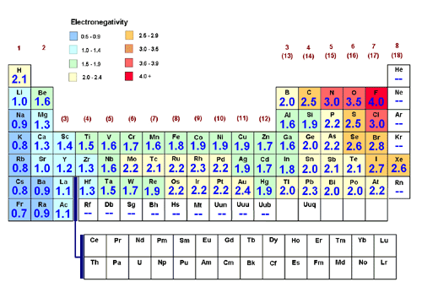
Electronegativity Values

Slide 16
Ch. 6.3: Naming Compounds and Writing Formulas
KEY TERMS:
Binary Compound: compound composed of two elements
Oxidation Number: tells you how many electrons an atom has gained, lost, or shared to become stable
Polyatomic ion: covalently bonded group of atoms that has a positive or negative charge and acts as a unit

Slide 17
Binary Compounds
NaCl
CaO
Li₂S
MgCl₂
H₂O
CO₂
CH₄

Slide 18
Polyatomic Ions

