Slide 1
Chapter 7 Chemical Reactions Ch 7.1 (pg 192-194): Describing Reactions Ch 7.2: Types of Reactions Ch 7.3: Energy Changes in Reactions Ch 7.4: Reaction Rates

Slide 2
Ch. 7.1 Key Vocabulary
Chemical Reaction – when a substance undergoes a chemical change
Reactants – the substances undergoing a change in a chemical reaction
Products – the new substances formed as a result of the chemical change
Chemical equation – a representation of a chemical reaction in which the reactants and products are expressed as formulas

Slide 3
Chemical Formula vs Chemical Equation
Chemical formula - tells what elements are in a compound and their ratios
Chemical equations - used to describe a chemical reaction.
Coefficients - Ex. 2NaCl or 3H₂O (numbers—tell # of molecules)
Chemical Formulas Ex. NiCl₂ or NaOH (letters and subscripts)
Chemical Equations NiCl_{2(aq)} + 2NaOH_{(aq)} → Ni(OH)_{2(s)} + 2NaCl_{(aq)} (letters, subscripts, and coefficients)

Slide 4
Helpful key terms…
Polyatomic ion: covalently bonded group of atoms that has a positive or negative charge and acts as a unit
Binary Compounds are composed of 2 elements. NaCl CaO MgCl₂
H₂O CO₂
CH₄

Slide 5
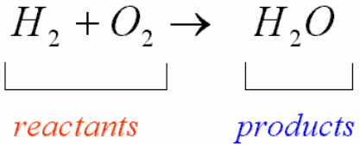
Reactants
Products
Produce

Slide 6
Conservation of Mass
States that mass is neither created nor destroyed in a chemical reaction
Just changes form.
Mass of the products = mass of the reactants
Have to have an equal number of atoms of each element on both sides.

Slide 7
Balancing Equations – pg. 194
Why do we balance chemical equations?
In order to show that mass is conserved during a reaction, a chemical equation must be balanced.
You balance by adding coefficients only.
1. Count # of atoms of each element on each side of the equation.
2. Change one or more coefficients until the equation is balanced.

Slide 8
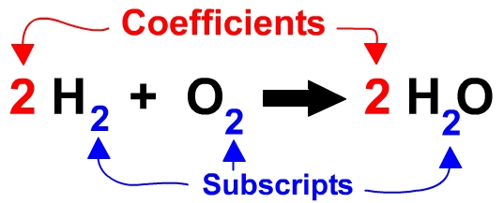
Balancing can’s and cannot’s
You CAN change the coefficients in front of the compound.
You CANNOT change the subscripts.
You CANNOT insert a coefficient in the middle of a compound.

Slide 9
Putnam’s 3 Steps:
Balance everything except H₂O!
Balance H
Balance O
OR… 1. Balance metals
2. Balance polyatomic ions
3. Balance nonmetals
4. Balance Hydrogen
5. Balance Oxygen

Slide 10
HgO → Hg + O₂
_{Atoms:}
_{Hg:}
_{O:}
Notes:
2HgO → 2Hg + O₂

Slide 11
Mg + O₂ → MgO
_{Atoms:}
_{Mg:}
_{O:}
Notes:
2Mg + O₂ → 2MgO

Slide 12
Li + H₂O → LiOH + H₂
_{Atoms:}
_{Li:}
_{H:}
_{O:}
Notes:
2Li + 2H₂O → 2LiOH + H₂

Slide 13
Ch 7.2 Types of Reactions
1. Synthesis
2. Decomposition
3. Single Displacement
4. Double Displacement
5. Combustion
Notes:
When an acid and a base are placed together, they react to neutralize the acid and base properties, producing a salt. The H+ cation of the acid combines with the OH- anion of the base to form water. The compound formed by the cation of the base and the anion of the acid is called a salt.

Slide 14
1. Synthesis Reactions
2 substances combine to form a different substance.
A + B → AB
Notes:
Putting a toy together…

Slide 15
2. Decomposition Reactions
A substance breaks down into 2 or more substances.
AB → A + B
2H₂O → 2H₂ + O₂
Notes:
Dead bodies decompose or break down into smaller parts…
Most decomp reactions require the use of heat, light, or electricity…like this one where electric current passed through water

Slide 16
3. Single Displacement Reaction
One element replaces another in the equation.
A + BC → AC + B
Ca + 2KCl → CaCl₂ + 2K
Metal replaces metal
Nonmetal replaces nonmetal
Cl₂ + 2KI → I₂ + 2KCl
Notes:
A girl goes to a dance with a boy B and ends up leaving with another boy A…
A and B are metals, while C is a nonmetal…
Avril goes to the dance by herself…Beyonce goes to the dance with Chris…
By the end of the night, Avril is with Chris and Beyonce is by herself…

Slide 17
4. Double Displacement
+ ion of one compound replaces the + ion of another compound
Sometimes get a precipitate—a solid that separates from the liquid.
AB + CD → AD + CB
Notes:
Two couples double date to the dance and end up switching partners by the end of the night…
Allison and Brad go to the dance…Claire and Donny double date with them…
By the end of the night, Allison and Donny are dancing, while Claire and Brad are dancing…

Slide 18
5. Combustion
Hydrocarbon + Oxygen produce CO₂ & H₂O giving off energy (as heat and light)
A + O₂ → CO₂ + H₂O + energy
Notes:
Think about how a candle needs oxygen to burn…
Most times it is an organic molecule with oxygen that yields carbon dioxide and water…
But not always…

Slide 19
CFU: Name that reaction!
1. Zn(s) + CuCl₂(aq) → ZnCl₂(aq) + Cu(s)
2. 2H₂(g) + O₂(g) → 2H₂O(g)
3. 2C₂H₆+ 7O₂→ 4CO₂+ 6H₂O
4. Ba(NO₃)₂(aq) + K₂SO₄(aq) → BaSO₄(s) + 2KNO₃(aq)
5. 2H₂O(l) → 2H₂(g) + O₂(g)
Notes:
EXIT SLIP?
Single displacement
Synthesis
Combustion
Double displacement
Decomposition

Slide 20
Card Sort Activity
I will pair you with someone nearby.
You will cut out one set of cards.
Organize cards into 5 categories (the 5 reaction types discussed in class).
Please note that columns may not be =

Slide 21
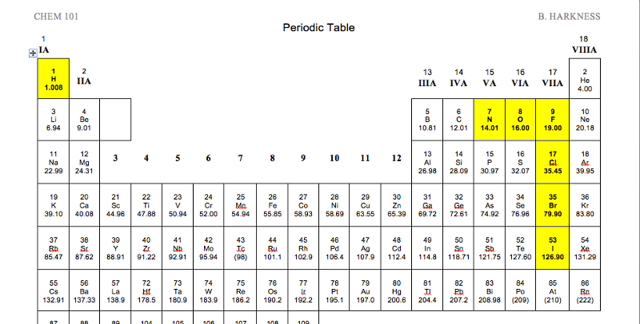
Diatomic Molecules

Slide 22
Predict products, Balance eq, and ID Reaction Type
Cu + AgNO₃ →
CH₄ + O₂ →
Mg + O₂ →
H₂O₂ →
Pb(NO₃)₂ + KI →
Notes:
FRIDAY DEMOS – predict the products
COMBUSTION - Methane and oxygen → carbon dioxide and water
SYNTHESIS - Magnesium and oxygen → magnesium oxide
DECOMPOSITION - Hydrogen peroxide → water and oxygen
SINGLE DISPLACEMENT - Copper and silver nitrate → copper nitrate and silver
DOUBLE DISPLACEMENT - Lead nitrate and potassium iodide → lead iodide and potassium nitrate
ANSWERS ON NEXT SLIDE

Slide 23
Examples of Reactions
Single Displacement
Cu + 2AgNO₃ → Cu(NO₃)₂ + 2 Ag
Combustion
CH₄ + 2O₂ → CO₂ + 2H₂O
Synthesis
2 Mg + O₂ →2 MgO
Decomposition 2H₂O₂ → 2H₂O + O₂(g) (MnO₂ as catalyst)
Double Displacement Pb(NO₃)_{2(aq)}+ 2 KI_{(aq)}→ PbI_{2(s)} + 2 KNO_{3(aq)}

Slide 24
Ch 7.:3 Energy Changes in Reactions
Chemical Energy – E stored in the chemical bonds of a substance
Breaking bonds takes energy
Bond formation releases energy
EX: Propane Grill C₃H₈ + 5O₂ → 3CO₂ + 4H₂O + Heat
Chemical reactions involve the breaking of chemical bonds in the reactants and the formation of chemical bonds in the products.

Slide 26
Exergonic vs Endergonic Rxns
Exergonic – less E is required to break the original bonds than is released when new bonds formed (heat releasing)
EX: glow sticks, heat packs, burning of wood, dynamite explosions, burning of fossil fuels
Endergonic – more E is required to break the original bonds than is released when new ones are formed (heat absorbing)
EX: electroplating of metal, cold packs

Slide 27
Chemical Reactions and Energy
Exothermic: Heat released due to exergonic reaction.
Example: burning wood; iron rusting
Energy comes from chemical bonds.
Endothermic
Heat is absorbed due to endergonic reaction.
Example: electroplating,
cold packs

Slide 28
Ch. 7.4: Reaction Rates
Reaction rate – rate at which reactants change into products over time
Temperature
Surface area
Concentration
Stirring
Catalysts – substance that affects the reaction rate without being used up in the reaction
Inhibitors
IT COMES DOWN TO COLLISIONS.
Reaction Rates Video Clip
Notes:
PRESSURE INCLUDES CONCENTRATION, TEMP AND VOLUME
P = F/A
F = ma (mass deals with concentration, acceleration deals with temperature)
A = deals with surface area
*SA – rubix cube
Catalyst: people throwing balls on one side of the room, people throwing cups on the other side of the room. A reaction only occurs if the ball lands in the cup. Catalyst would be someone in the middle catching the balls and cups and putting them together.
Inhibitors: cups filled with socks (competitive) OR a stick attached to the cup so the cup can’t catch the ball (non-competitive inhibitor)

Slide 29
Apply to predict!
I have one beaker of hot water and one beaker of cold water. I add one drop of food coloring to the center of each container. What will happen? Describe how this parallels reaction rates.
I have a large pitcher of iced tea that I need to sweeten with several cubes of sugar. Describe two methods to speed up the dissolving time.

Slide 30
Apply to predict, cont.
Adding a magnesium strip to vinegar will cause it to fizz. How could I test the affect temperature has on the reaction rate? What would you predict and why?
Adding an Alka Seltzer to water causes a chemical reaction. What are two ways to affect the reaction rate?

Slide 31
Discussion Questions
Pieces of zinc metal react with hydrochloric acid, producing bubbles of hydrogen gas and a solution of zinc chloride. Which of the following is NOT likely to increase the rate at which this reaction occurs?
a. Grinding the zinc into a powder
b. Diluting the hydrochloric acid
c. Stirring the acid
d. Heating the hydrochloric acid

Slide 32
Discussion Questions
2. For the reaction of zinc metal with hydrochloric acid, explain why:
a. Concentrated hydrochloric acid reacts at a faster rate than dilute hydrochloric acid.
b. Zinc powder reacts faster than pieces of zinc.
c. The reaction occurs faster at 60 degrees C than 20 degrees C.

Slide 33
Reaction Rates Demos
Lifesaver
Alka Seltzer
Fruit Fresh – discussed only
.2H₂O(l) → 2H₂(g) + O₂(g) **MnO₂**
Iodine Clock Reaction
IO₃⁻_{(aq)} + 3HSO₃⁻_{(aq)} → I⁻_{(aq)} + 3SO₄²⁻_{(aq)} + 3H⁺_{(aq)}
2. 5I⁻_{(aq)} + 6H⁺_{(aq)} + IO₃⁻ → 3I_{2(aq)} + 3H₂O_{(l)}
A. Potassium Iodate – KIO₃
B. Sodium Bisulfite – NaHSO₃ + starch
Notes:
Lifesaver – SA
Alka Seltzer – SA and Stirring
Fruit Fresh – inhibitor
Iodine Clock Reaction – concentration and temperature
The starch (not shown) and the molecular iodine (I₂) produce the color
Concentration, temperature, surface area, catalyst

