Slide 1
Thermal Energy and Matter
Chapter 16.1
Notes:
Matter is made up of tiny particles that are in constant motion.
Hot move faster
Cold move slower

Slide 2
Access prior knowledge! What will happen if…
Samples of water (same masses) at different temperatures are mixed?
A large metal bolt and a small metal bolt are heated to the same temperature and then dropped into equal amounts of room temperature water?
You touch a metal seatbelt that’s been in the sun all day? You touch a cloth car seat that’s been in the sun all day?
Notes:
Heat lost by the higher temp sample is the heat gained by the lower temp sample (TEMP)
Energy of a sample depends not only on its temperature, but also its mass (MASS)
Some types of matter heat up and cool down faster than others (SPECIFIC HEAT)

Slide 3
Access more prior knowledge…
What is mechanical energy?
What is thermal energy?
How are they alike? Different?
Notes:
ME = KE + PE (large scale) Units - Joules
Thermal E = KE + PE (molecular scale) Units - Joules

Slide 4
Temperature
What do you do when you are sick? You T.A.K.E. your temp! Temp = Average Kinetic Energy
Describe the movement of particles with low temps. High temps?
What are the units for temperature?
Notes:
Low temps → slower
High temps → faster
Celsius, Fahrenheit, SI unit is Kelvin (absolute zero)

Slide 5
Temperature Scales
Fahrenheit temperature scale is a scale based on 32 for the freezing point of water and 212 for the boiling point of water, the interval between the two being divided into 180 parts.
Celsius temperature scale also called centigrade temperature scale, is the scale based on 0 for the freezing point of water and 100 for the boiling point of water.
Kelvin temperature scale is the base unit of thermodynamic temperature measurement in the International System (SI) of measurement. Its zero point is absolute zero, the theoretical temperature at which the molecules of a substance have the lowest energy. The Kelvin scale is related to the Celsius scale. The difference between the freezing and boiling points of water is 100 degrees in each, so that the kelvin has the same magnitude as the degree Celsius.

Slide 6
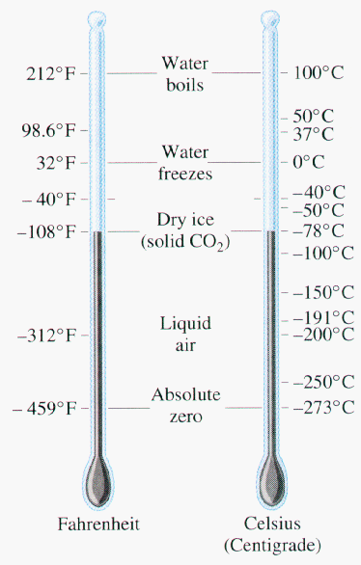
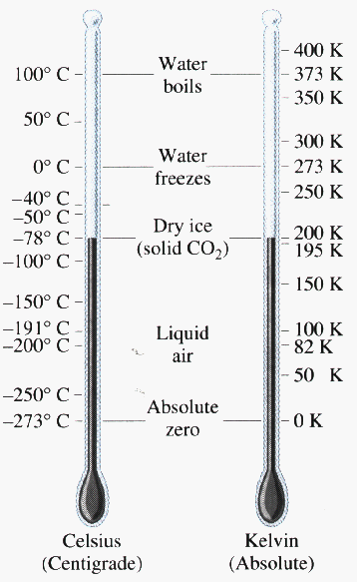

Slide 7
Thermal Energy
Remember that thermal energy is the total of potential and kinetic energy related to the motion of all the particles in an object.
Thermal E depends on the mass, temperature, and phase of an object.
Notes:
Intro phase change here with the potential energy

Slide 8
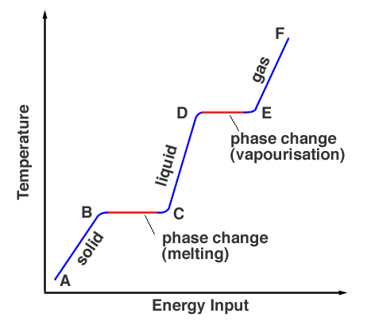
With a phase change, PE stored in between molecules needs to be overcome by the KE of the particles
Latent (hidden) heat – energy required to change the phase of a substance
Solid → Liq – latent heat of fusion
Liq → Gas – latent heat of vaporization
Energy required is:
Q=mL, where m is mass and L is the specific latent heat of fusion or vaporization (heat energy to change 1kg of substance to liquid or gas.

Slide 9
Which has more thermal energy…
A cup of tea or a teapot full of tea, both at the same temperature?
A cup of cold tea or a cup of hot tea, both with the same mass?
A small cup of hot tea or a large pitcher of lemonade?
Notes:
Teapot full of tea → MASS wins
Cup of hot tea → TEMP wins
Large pitcher of lemonade → the tea particles are only moving slightly faster, and the lemonade has many more particles than the tea, so the MASS wins in this case…

Slide 10
Thermal Energy and Mass
↑ mass = ↑ KE
↑ KE = ↑ Thermal Energy
So: ↑ mass = ↑ Thermal Energy

Slide 11
Thermal Energy and Temperature
↑ Temperature = ↑ KE
↑ KE = ↑ Thermal Energy
So: ↑ Temperature = ↑ Thermal Energy
PE will stay the same until it changes state…

Slide 12
Heat
Heat is the transfer of thermal energy from one object to another because of…
Heat flows spontaneously from _____ objects to _____ objects.
Why does heat flow the way it does?
Explain the heat transfer holding an ice cube in your hand.
Heat is measured in what units?
Notes:
A difference in temperature
Hot, cold
One way heat flows is by the transfer of energy in collisions. On average, high-energy particles lose energy, and low-energy particles gain energy in collisions.
Joules

Slide 13
Calculating Change in Thermal Energy
Q = m x ΔT x C
The heat (Q) absorbed by a material equals the product of the mass (m), the specific heat (C), and the change in temperature (ΔT).
Remember that ΔT = Final Temp – Initial Temp
↑ heat = T_{final} > T_{initial} and +Q
↓ heat = T_{final} < T_{initial} and -Q

Slide 14
What is Specific Heat? C?
The amount of heat that is needed to raise the temperature of 1 kg of material by 1˚C or 1 K.
Unit = J/(kg K) Joules/kilogram kelvin
Water has the highest specific heat of other common materials.
Which seems cooler in the summer: the ocean or the sand? See pg. 476
Why don’t coastal temperatures vary much year-round?
Why is water useful as a coolant?
Land vs Water
Notes:
Ocean seems cooler in the summer – water has a higher specific heat, so it takes more energy to change the temperature than sand
Water is useful as a coolant because it can absorb a lot of heat without changing temperature very much.

Slide 15
Practice Time
The temperature of a 32-g silver spoon increases from 20 degrees C to 60 degrees C. If silver has a specific heat of 235 J/(kgK), what is the change in the thermal energy of the spoon?
A 45-kg brass sculpture gains 203,000 J of thermal energy as its temperature increases from 28 degrees C to 40 degrees C. What is the specific heat of brass?

Slide 16
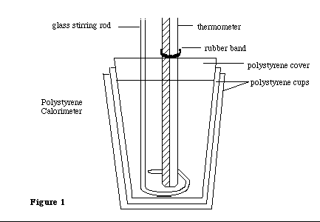
Measuring Specific Heat
Use a calorimeter
Calculate the temperature change of the water around the heated object.

Slide 17
Make more sense now?
Samples of water at different temperatures are mixed?
A large metal bolt and a small metal bolt are heated to the same temperature and then dropped into equal amounts of room temperature water?
You touch a metal seatbelt that’s been in the sun all day? You touch a cloth car seat that’s been in the sun all day?
Notes:
Heat lost by the higher temp sample is the heat gained by the lower temp sample (TEMP)
Energy of a sample depends not only on its temperature, but also its mass (MASS)
Some types of matter heat up and cool down faster than others (SPECIFIC HEAT)

Slide 18
Measure C Lab Example
1. Heat a known mass of a metal to a known temperature (say, for example, 10.00 g at 78.5 deg C) 2. Add the metal to a known mass of water at a known temperature (say 75.00 g at 25.0 deg C) in a calorimeter. 3. Let the metal and the water come to an equilibrium temperature, Tf. (The metal cools from 78.5 to Tf; the water warms from 25.0 to Tf.)
Notes:
The heat lost by the metal equals the heat gained by the water (assuming the calorimeter absorbs none of the heat). The heat loss of the metal is - Heat Lost = specific heat x 10.00 g x (78.5 - Tf) The specific heat of water is known to be 4.184 J/g C. Heat Gained = 4.184 x 75.00 g x (Tf - 25.0) Since the Heat Lost = the Heat Gained, and the final temperature, Tf, can be measured, the only unknown is the specific heat of the metal. Assume Tf = 28.00 deg specific heat x 10.00 x 50.5 = 4.184 x 75.00 x 3.00 specific heat = 0.445 J/g C

Slide 19
Measure C example cont.
The heat lost by the metal equals the heat gained by the water (assuming the calorimeter absorbs none of the heat).
Heat Lost by metal = specific heat x 10.00 g x (Tf – 78.5)
The specific heat of water is known to be 4.184 J/g K. Heat Gained by water= 4.184 x 75.00 g x (Tf - 25.0)
Since the Heat Lost = the Heat Gained, and the final temperature, Tf, can be measured, the only unknown is the specific heat of the metal.
Assume Tf = 28.00 deg C x 10.00g x -50.5 deg = 4.184 J/gK x 75.00g x 3.00 deg
Specific heat = ??
Notes:
C of metal = 0.445 J/g C

Slide 20
Ch 16.2 Transferring thermal energy
Conduction
The transfer of energy has heat through a material/matter by direct contact (PICTURE)
Convection
The transfer of energy in a fluid (liquids and gases) due to differences in temperature (and thus density)
The heated fluid expands and rises (due to decreased density) while the cooler fluid cools and becomes denser
Rise and fall of material is called a convection current (PICTURE)
Radiation
The energy that is transferred as electromagnetic waves
NEXT

Slide 21
Conduction
BACK

Slide 22
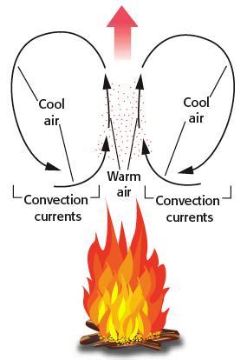
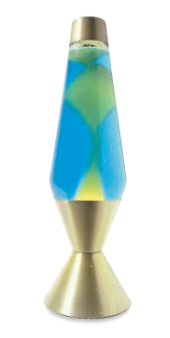
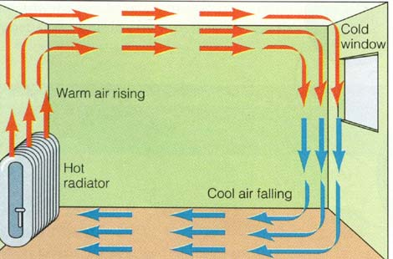
Convection
BACK

