Slide 1
Energy
Chapter 4

Slide 2
What is energy?
Energy is the ability to do work (cause change).
When a force causes an object to be displaced, work was done upon the object.
Examples: brushing your hair, walking down the hall, eating your lunch, yawning.

Slide 3
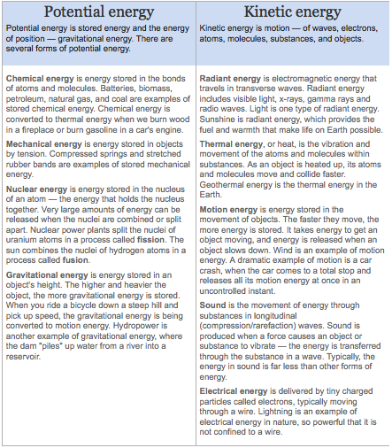
What are different forms of energy?
http://www.eia.gov/kids/energy.cfm?page=about_forms_of_energy-basics

Slide 4
Kinetic Energy
Energy in the form of motion.
Depends on mass and velocity (similar to momentum)
Examples: spinning bicycle wheel, a car driving

Slide 5
Calculating Kinetic Energy
Kinetic energy = ½ mass x velocity²
KE = ½ m x v²
↑mass = ↑ kinetic energy ↑ velocity = ↑ kinetic energy
If you double the velocity, the energy quadruples.
Joule
Mass = kg; velocity = m/s

Slide 6
Let’s Practice!
A 15-kg bicycle carrying a 50-kg boy is traveling at a speed of 5 m/s. What is the kinetic energy of the bicycle (including the boy)?
812.5 Joules (J)
The kinetic energy of a boat is calculated at 52,000 J. If the boat has a mass of 39,000 kg, with what velocity is it moving?
1.63 m/s

Slide 7
Potential Energy
Potential energy = stored energy due to position
Examples: an apple hanging in a tree; a book on a shelf

Slide 8
Elastic Potential Energy
Energy stored by something that can stretch or compress
Examples: a rubberband or a spring

Slide 9
Chemical Potential Energy
Energy stored in chemical bonds between atoms
Examples: Food, gasoline

Slide 10
Gravitational Potential Energy
Energy stored in objects above Earth’s surface.
GPE = m x 9.8 m/s² x h
Mass – kg, height - meters
(↑ h = ↑ GPE)
measured in joules

Slide 11
More Practice!
A 0.06-kg tennis ball starts to fall from a height of 2.9 m. How much gravitational potential energy does the ball have at that height?
1.7 J
An object of mass 10 kg is raised through a certain height. Its potential energy is increased by 1960 Joules. Find the height of the object initially.
20 m

Slide 12
Let’s Review KE and PE
How are kinetic energy and potential energy different?
What are the three types of potential energy?
How are elastic potential energy and chemical potential energy different?

Slide 13
Conservation of Energy
Energy is not lost or gained; it changes form.
Transforming Energy
Often electrical energy is converted to light and thermal energy
Examples: light bulb, alarm clock, curling iron, computers
Chemical energy is usually converted to kinetic energy or thermal energy.
Examples: Your body, food, vehicles

Slide 14
Conversions
Mechanical energy (ME) = potential energy (PE) + kinetic energy (KE)

Slide 15
Falling Objects
100% PE 0% KE
Falling = change from PE to KE
Ground: 0% PE 100% KE

Slide 16
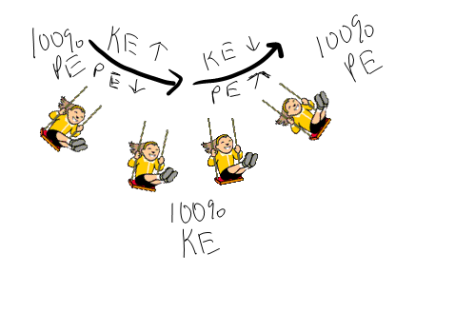
Swinging Energy

Slide 17
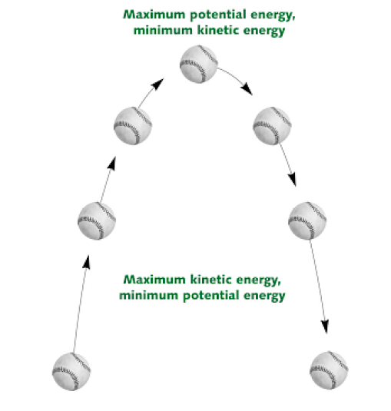

Slide 18
Conservation of Energy
Energy cannot be created or destroyed, ONLY transferred from one to another…..

Slide 19
Finding Energy Transformations
Friction: seems like energy is disappearing, but it is actually converted into different energies, such as thermal energy.
Mass into Energy: Nuclear fusion is an example. Remember e=mc². A little mass = a lot of energy
Two hydrogen nuclei come together and combine to form one helium
Nuclear Fission: Kinetic Energy to thermal energy
Mass into energy again!
Nuclei broken apart… ENORMOUS energy

Slide 20
Energy Conversions in Your Body
Chemical energy to kinetic and thermal energy.
Stores energy as fat, example of potential energy
Also converts to heat and use this energy to move
Maintaining Healthy Weight
Must have proper balance between energy contained in food eaten and energy body uses

