Slide 1
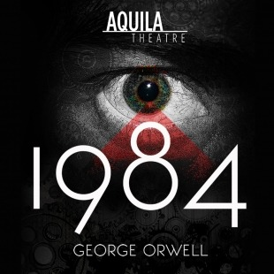
The Lied Center for Performing Arts
February 19, 2020

Slide 2
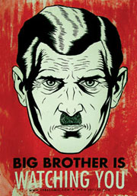
Big Brother
A person or organization exercising total control over people’s lives
The phrase refers to the government's surveillance of the people with listening devices and cameras, in a totalitarian society, where Big Brother is the head of the totalitarian regime.

Slide 3
1984 Synopsis
“In the throes of unprecedented challenges to privacy, truth, and personal expression, Aquila Theatre brings 1984, George Orwell’s cautionary novel, to the Lied Center. Written in 1944 near the end of World War II, 1984 depicts a society controlled by a perfectly totalitarian government bent on repressing all subversive tendencies. ‘Big Brother’ is always watching and technology is wielded as a weapon to inundate citizens with propaganda and to monitor thoughts and actions. Imagined before the existence of computers, this dystopian future explores the power of technology as a mental manipulator and source of curated information” (Lied Center webpage).

Slide 4
Video
Aquila Theatre in George Orwell's 1984

Slide 5
Essential Questions
What similarities and differences might be paired between the lives found in 1984 and ours today? Between 1984 and [the time that you are studying in SS]?
Do individuals have the power to change the society in which they live?
Can a society based on hate survive?
What might cause the fall of Big Brother?
Can Big Brother decide what is real and what is not?
Is technology taking us closer to the world of Big Brother?

Slide 6
Let’s go!
Parent permission forms need to be signed and handed in by Monday, February 3rd.

