Slide 1
Ideal Gas Law

Slide 2
Ideal Gas Assumptions
Assumptions for ideal gases
Gases are made of molecules that are in constant, random motion.
Pressure is due to particle collisions with one another and the walls of their containers.
All collisions are perfectly elastic (no energy lost).

Slide 3
Ideal Gases
2 key assumptions of ideal gases
There is no attraction or repulsion between gas molecules.
Ideal gas particles have no volume
An ideal gas does not really exist, but it makes the math easier and is a close approximation.

Slide 4
Conditions where gases are CLOSE to ideal
Many gases behave close to “ideal” under:
High temps: particles move fast enough to make attraction/repulsion between particles negligible.
Low pressure: particles are very spread out so their volume is negligible to their container (they don’t take up space).

Slide 5
Ideal Gas Law
PV = nRT

Slide 6
Variables
P = pressure (kPa or atm)
V = volume (L)
n = moles
R = gas constant (8.314 L*kPa/mol*K), 0.0821 L*atm/mol*K)
T = temp (K)
Units must match!

Slide 7
Moles
n = moles
A mole is the amount of substance in a given mass of substance.
n = mass (g)/ molar mass
Molar mass = mass of atoms in an element or compound.
Ex. H₂0
H = 1.008g O = 16g ⇒ 1.008(2) + 16 = 18.02 g/mol

Slide 8
Example:
If I contain 2.1 moles of gas in a container with a volume of 62.0 L and a temperature of 157.3 C, what is the pressure inside that container?
P = ? T = 157.3 C
V = 62.0L R = 8.314 L*kPa/(mol*K) or
N = 2.1 moles R = 0.0821 L*atm/(mol*K)

Slide 9
How does my pressure and my temperature affect my Phase????
When we talk about the melting and pointing point of water at 0C and 100C we are assuming we are at approximately sea level where we have an atmospheric pressure of 1atm
When you go up to the mountains you are at a higher elevation and at a lower atmospheric pressure. Because of this, your water will boil at lower temperature.
If I could drill a deep hole a mile into the Earth, my boiling point would increase

Slide 10
Phase Changes Revisited

Slide 11
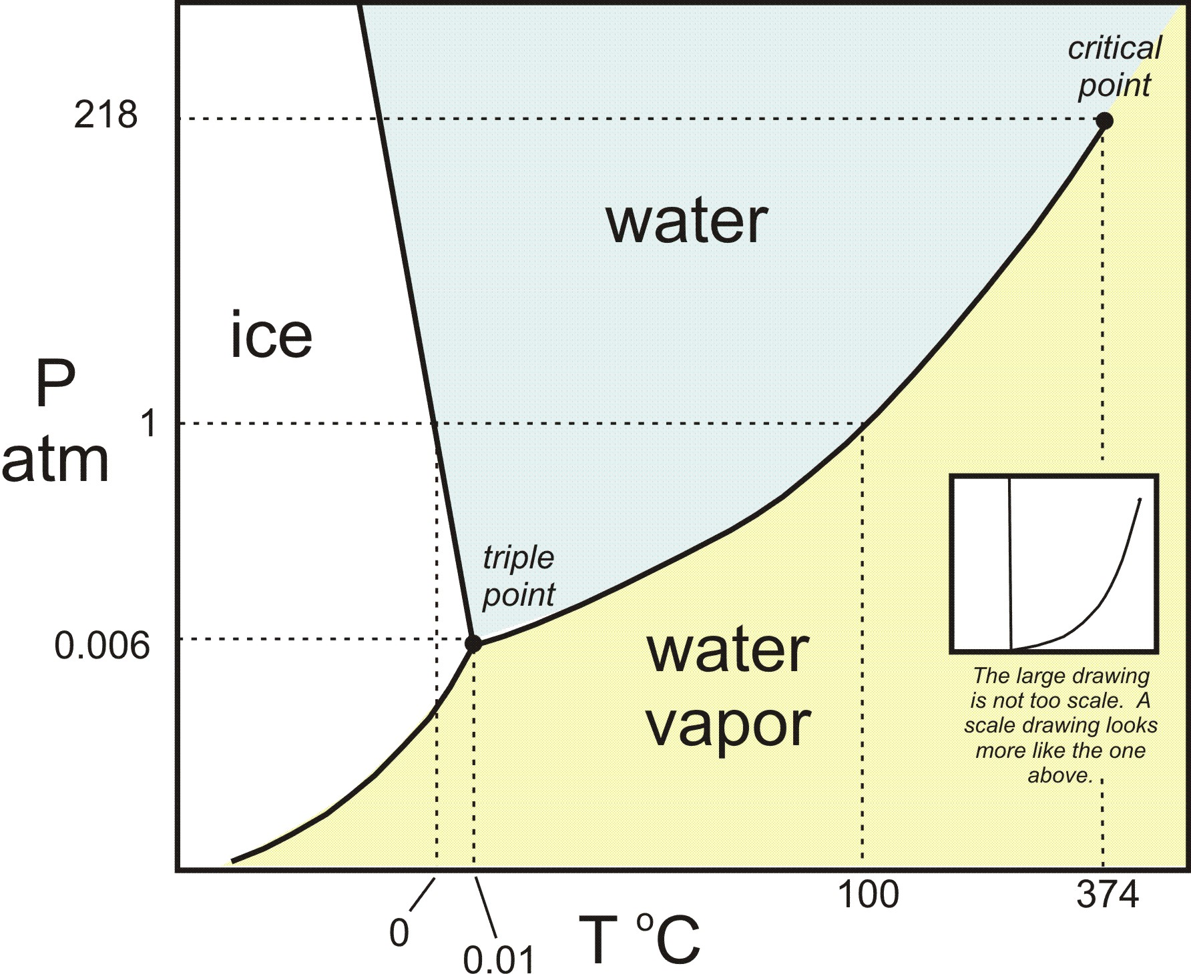

Slide 12
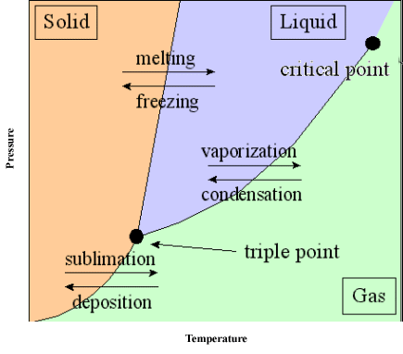

Slide 13
Energy during a Phase Change
How can I calculate how much heat energy I need for a phase change?
We know how to calculate how much heat energy we need to increase our kinetic energy of our matter using our specific heat calculation
Q = mCΔT
When we are changing phases the heat energy we are adding is in terms of POTENTIAL energy which goes into breaking bonds and allowing the particles to be FURTHER from each other

Slide 14
How to Calculate Latent Heat
There is no change in temperature so no change in KE, just an increase in PE as the particles are allowed to move further from each other. (remember from 1st semester? Higher PE means more distance between particles)
Heat of Fusion - Amount of heat needed to change from a solid to a liquid (or amount of heat lost to go from a liquid to a solid)
Heat of Vaporization - Amount of heat needed to change from a liquid to a gas (or amount of heat lost to go from a gas to a liquid)

Slide 15
Latent Heat Calculation
Q = mL
Q = heat energy (J)
m = mass (g)
L = Latent Heat Value (J/g)

