Slide 1
Question of the Day
What determines the path of the life cycle for a star?
WWBAT: Describe the three types of galaxies
Notes:
Size

Slide 2
Galaxies
CH 25.3

Slide 3
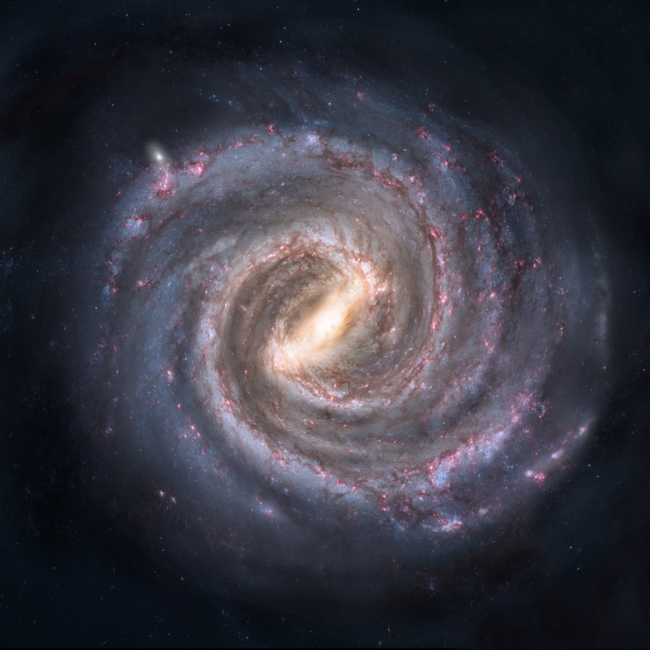
Galaxy
Definition: Large groups of stars, dust, and gases held together by gravity
Different Galaxies
Milky Way (our galaxy)
Andromeda
Large and Small Magellanic
clouds
The center is called the
galactic nucleus

Slide 4
Milky Way
We are not the center of the galaxy
We are actually within an arm of the spiral
The use of Radio Telescopes have allowed us to see our location and size of galaxy
We are about 30,000 light-years from the nucleus
One revolution for our solar system: 230 million years
About 100,000 light years across and 10,000 light years thick at the center.
Notes:
There may be 400 billion stars in our galaxy

Slide 5
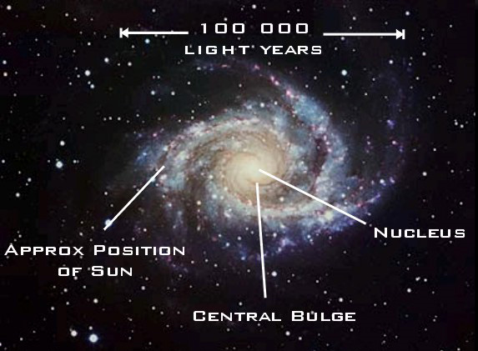

Slide 6
Types of galaxies
The universe includes hundreds of billions of galaxies
There are 3 basic types of galaxies
Spiral galaxies
Elliptical galaxies
Irregular galaxies
The types are based off size and shape

Slide 7
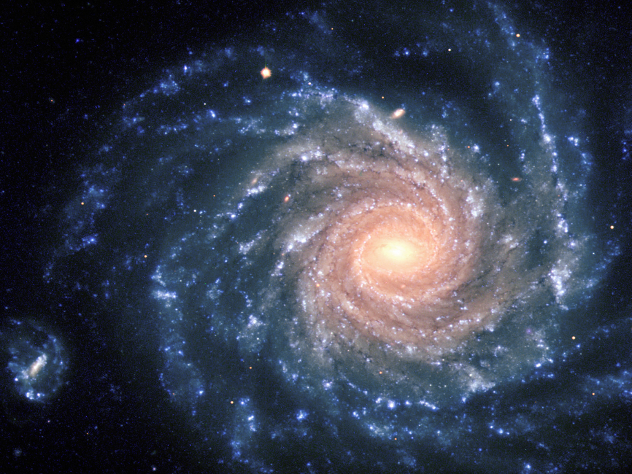
Spiral Galaxies
Disk-shaped with more stars near the center
“arms” of stars extend from the center
Looks like the galaxy is spinning
The arms spin slower than the center
Spiral galaxies have both old
and young stars
Younger stars in the arms
About 20% of galaxies are
spiral galaxies

Slide 8
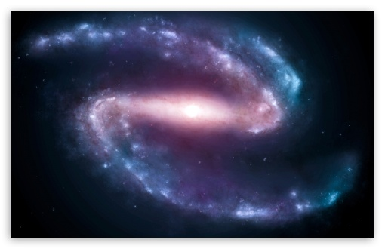
Barred spiral galaxy
A few of the “arms” appear to be straight, which gives the appearance of a bar
The “bar” will stay rigid and spin as one unit
About 10% of galaxies are barred spiral
Recent evidence
indicates the
Milky Way may be
barred

Slide 9
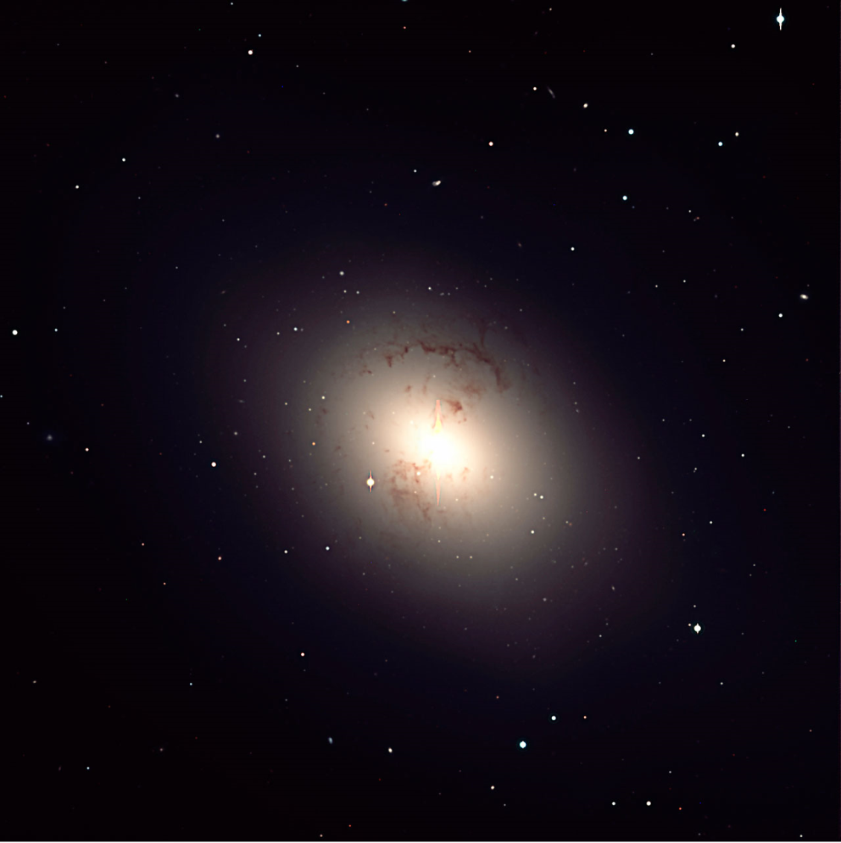
Elliptical Galaxies
Appear to be round or oval
Do not have spiral arms
Made mostly of old stars
Most of the galaxies are
are small but the largest
is 200,000 light-years in diameter
60% of galaxies

Slide 10
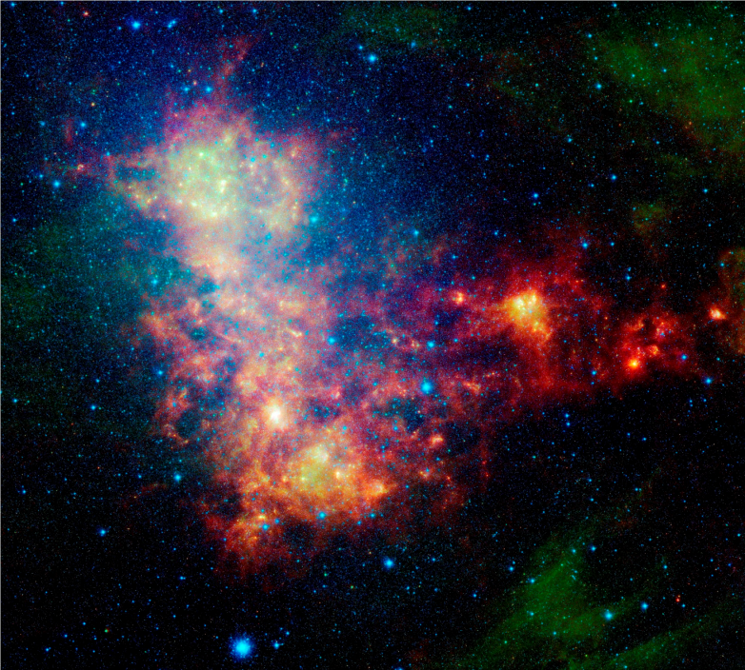
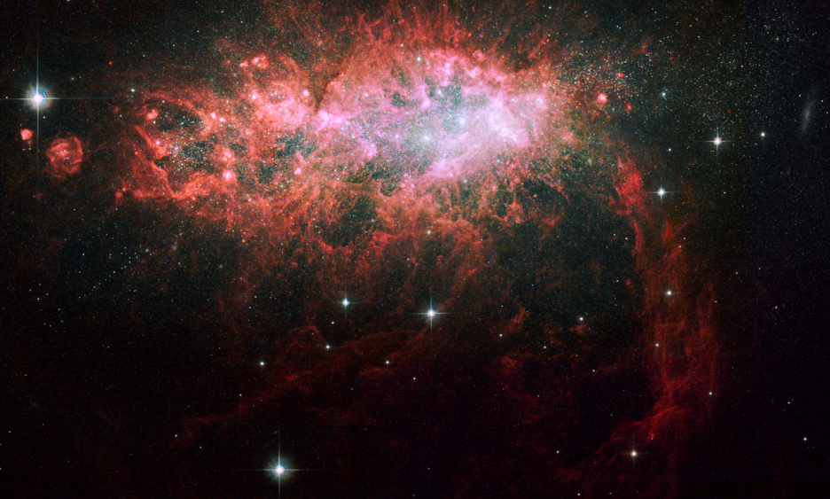
Irregular galaxies
No defined or common shape
About 10% of galaxies
Made of mostly young stars
Notes:
The Large and Small Magellanic Clouds are the nearest neighbors at 150,000 light-years away

Slide 11
Question of the Day
What are the three types of galaxies?
WWBAT: describe the formation of galaxies

Slide 12
Galaxy Clusters
Definition: a system of galaxies containing from several to thousands of member galaxies
Own cluster is the Local Group
Contains at least 28 galaxies
3 spiral, 11 irregular, and 14 ellipticals

Slide 13
Quasars
Are very bright and very far away
Look like stars but their light takes billions of years to reach earth
Believed to have been created when the universe was very young
Must emit huge amounts of radiation or would be too dim for us to detect
Theory: they are massive black holes in the center of very young galaxies

Slide 14
Red Shift/Hubble’s Law
25.3

Slide 15
Red Shift
Most galaxies are found to have a red shift
Meaning the apparent wavelength is longer than it should be
Galaxies are moving away from our own galaxy
Relationship: galaxies that exhibit the greatest red shifts are the most distant
Notes:
Takes the Doppler effect into account
Dimmer galaxies were probably farther away than brighter galaxies

Slide 16
Hubble’s Law
Definition: galaxies are retreating at a rate proportional to their distance
All galaxy clusters will move away from each other
The indication is that the universe is expanding
Notes:
The farther away a galaxy is, the faster the galaxy moves away

Slide 17
Question of the Day
Which direction is our galaxy moving from the Small and Large Magellanic Clouds?
WWBAT: Describe the Big Bang Theory
HW: Review Sheet

Slide 18
Big Bang Theory
25.3

Slide 19
Big Bang Theory
At one time, universe was confined to a dense, hot supermassive ball
About 13.7 billion years ago, a violent explosion occurred
All matter and space were created at an instant
Widely accepted theory for how the universe started
Notes:
Matter went in all directions after the explosion
atoms were created through this explosion-tested with particle accelerators

Slide 20
Evidence for Big Bang Theory
Red Shift of the galaxies
Microwave background radiation
Radio signals coming from every direction
May have been produced during Big Bang
Particle accelerators creating matter that may have been present
Notes:
Several hundred thousand years of cooling then atoms formed

Slide 21
Big Crunch?
2 views to the ending of the universe
Continue to expand outward
Collapse of the universe in on itself
Most likely: Continue to expand outward with no end point
Notes:
Do we really know?

Slide 22
Question of the Day
What is one piece of evidence for the Big Bang Theory?
WWBAT: All objectives
HW: Study for Quest

