Slide 1
Properties of stars
25.1

Slide 2
Question of the day
What is at the center of our solar system?
WWBAT: Identify properties of stars

Slide 3
Steps of the solar system
Star→ Star System→ Star Group→ Galaxy → Galaxy Cluster→ Super Cluster→ Universe
Our star system: Solar System
Our Galaxy: Milky Way
Our Star Group: Local Group

Slide 4
Characteristics
Color and temperature:
The hottest stars emit small wavelengths which have a bluer color
~30,000 K
The colder stars emit longer wavelengths which have a redder color
The stars in the middle appear yellow like our sun
~5,000 K- 6,000 K

Slide 5
Characteristics
Binary stars
Definition: One of two stars revolving around a common center of mass under their mutual gravitational attraction
This concept helps us determine a stars mass
If the orbit is known the mass can be determined
Notes:
Mass is the hardest to calculate
Pg. 701 diagram for stars

Slide 6
Measuring distance
Parallax
Definition: light shifting in the apparent position of a nearby star due to the orbital motion of earth
The nearest stars will have the largest angles, shift, while the farthest ones will have almost no shift
Light-year
Definition: the distance light travels in one year
Travels about 9.5 trillion kilometers
Closest star is 4.3 light-years away
Notes:
Pg. 702 diagram for the angle
We can use the angles from parallax to find the distance in light years…?

Slide 7
Describing brightness
Apparent magnitude
Definition: the brightness of a star when viewed from Earth
Three factors control the apparent brightness of a star
Size, temperature, and distance from Earth
Absolute magnitude
Definition: the apparent brightness of a star if it were viewed from a distance of 32.6 light years
Notes:
Absolute is used to compare true brightness of stars

Slide 8
Hertzsprung-russell (h-r) Diagram
Definition: Shows the relationship between the absolute magnitude and temperature of stars
About 90 percent of the stars are main-sequence stars
Main sequence star: a star that falls into the main sequence category on the H-R diagram
Main sequence can be found in a band that runs from the upper left corner to the lower right corner
The diagram shows size as well as temperature

Slide 9
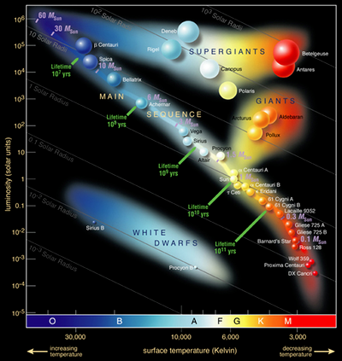
H-r diagram
The diagram shows size
as well as temperature

Slide 10
Cepheid Variables
Definition: a star whose brightness varies periodically because it expands and contracts (pulsating star)
The time between the occurrences of the maximum brightness is called the light period.
The longer the period the higher the absolute magnitude
This is another way to measure distance

Slide 11
Nova
Definition: a star that explosively increases in brightness
What happens
Usually reaches maximum brightness in a few days
Stays the maximum brightness for a few weeks
Over the next year will slowly return back to original brightness
Only some mass is lost, therefore, a star may go through this process more than once
Notes:
Most often happens in binary systems, red giant feeds gas to the white dwarf through gravity. Eventually the white dwarf goes through the nova and gets rid of most of the gas

Slide 12
Question of the day
What are two properties of stars that allow us to find distance?
WWBAT: Describe the life cycle of a star
HW: Finish the poster

