Slide 1
Chapter 17: Plate tectonics
Notes:
Why are there differences in elevation?....

Slide 2
Video links
100 Greatest Discoveries: Continental Drift 2:27
https://live.myvrspot.com/iframe?v=fYjY1YTIyY2VjYmIyODYxNzNkNWQwYTI3YmJkMTcwZGU
Seafloor Spreading with Bill Nye 4:02
https://live.myvrspot.com/iframe?v=fYTk5NDVmNjhhZDZkMTExZjM2Zjk3MzFhYmM0NzAzMDg
100 Greatest Discoveries: Seafloor Spreading 1:26
https://live.myvrspot.com/iframe?v=fNDRjMWUwODNmZDYzNGQ2YWZiODRmMDU2ZTRiNzc2MzI
100 Greatest Discoveries: Plate Tectonics 2:20
https://live.myvrspot.com/iframe?v=fODdhOGE0Y2FmYzg5NDNlNWUwN2NiMjZlOTgzYjJhY2Y

Slide 3
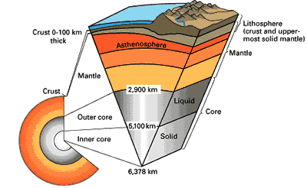
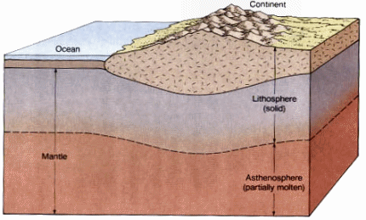
Background Knowledge
Lithosphere – the rigid outer layer of the earth. The continental crust and oceanic crust.
Continental crust – land
Oceanic crust – ocean floor
Asthenosphere – layer of rock just below the lithosphere. It is solid but soft. (The mantle)

Slide 4
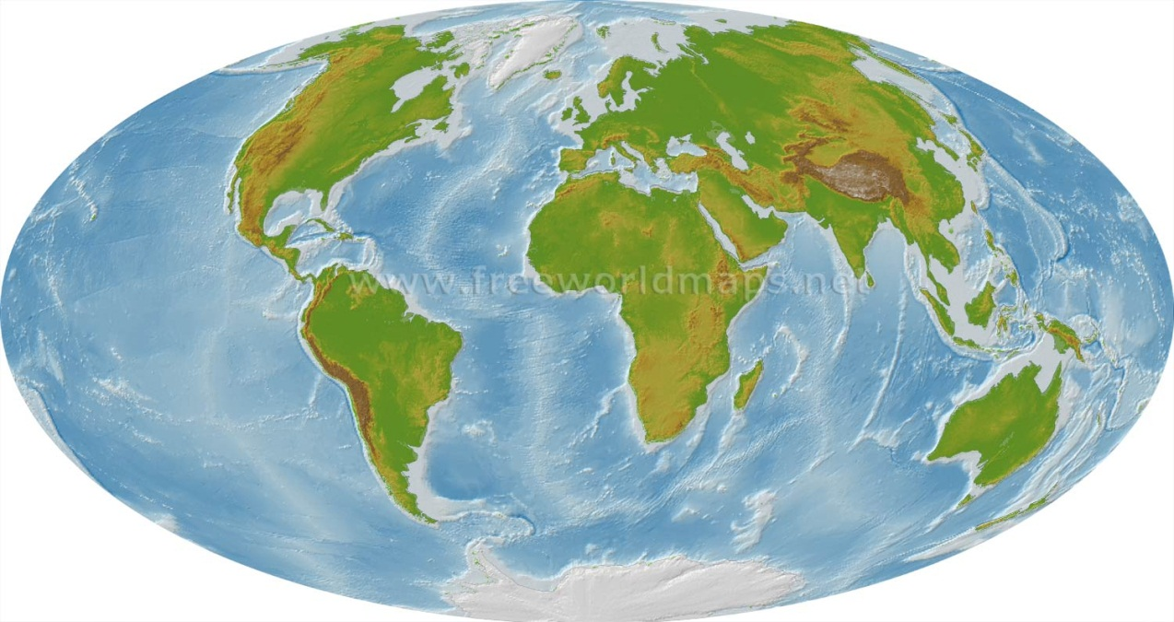
The continental puzzle..
Do you notice anything about the shape of the continents?

Slide 5
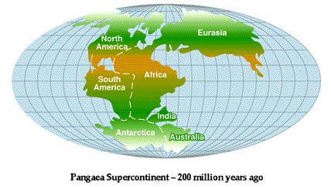
Sec 17.1 Continental drift
Alfred Wegener, a German scientist, noticed that the coastlines of South America and Africa looked like they could fit together like a puzzle.
In 1915, he proposed his hypothesis of Continental Drift.
Continental Drift – the continents had once been joined to form a single supercontinent called Pangaea.
He hypothesized that over the last 200 million years the continents broke apart and drifted slowly to their positions today.

Slide 6
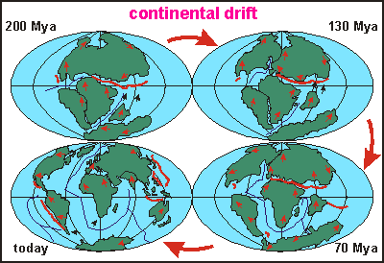
Continental Drift

Slide 7
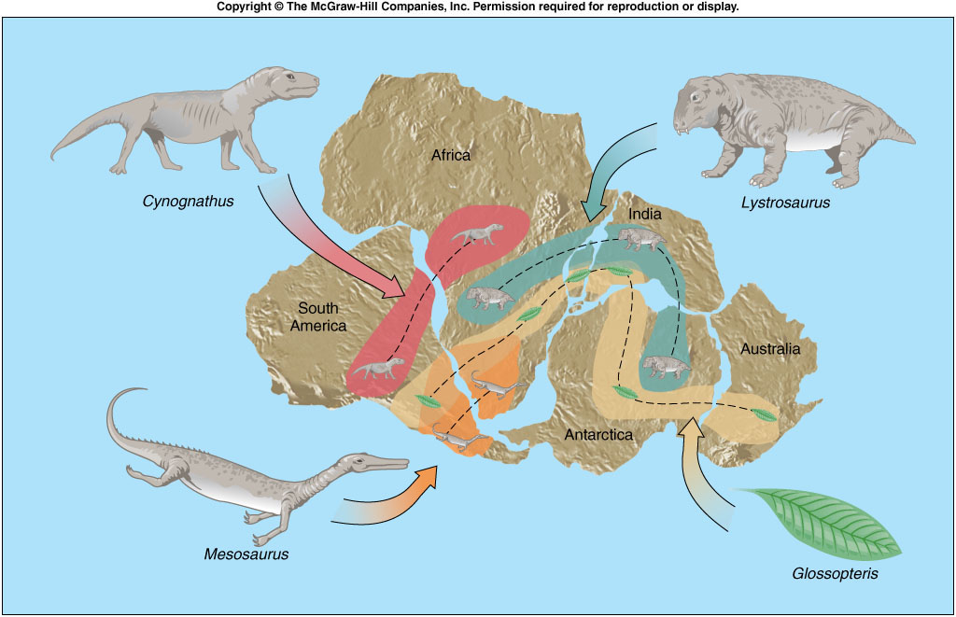
Evidence - 1
Scientists need evidence to back up their claims.
Fossils – fossils from the same ancient animals were found in South America and Africa.
Mesosaurus - A reptile that could not have lived in salt water.
South America and Africa must have been joined at one time.
Think jigsaw puzzle.

Slide 8
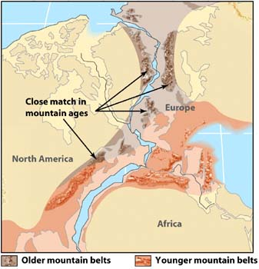
Evidence - 2
Rock types – Today there are matching rock types within mountain belts on different continents.
Appalachian Mountains in the U.S. and mountains in Britain and Scandinavia share similar rock types and ages.

Slide 9
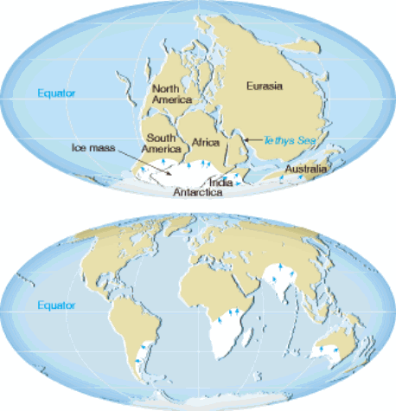
Evidence - 3
Ancient climates – Wegener also found evidence of similar climates on different continents.
Glacial till – deposits of glacial sediment on continents that are now in tropical climates. Also, rocks scratched by glaciers.
Evidence that North America had tropical swamps. We know that North America does not have tropical swamps now.

Slide 10
Nature of science…
Wegener’s hypothesis of continental drift was a new, radical idea.
Other scientists thought Wegener was wrong. His hypothesis was rejected!
Why? Because Wegener did not know exactly what caused the continents to move.
Eventually, technology led to new discoveries and the acceptance of continental drift.

Slide 11
Check for understanding, pg
What early evidence suggested that Earth’s continents might be moving?
List the three types of evidence outlined in the text and explain how they support Wegener’s theory.
Why was Wegener’s hypothesis rejected by most scientists of the early 1900’s?
Notes:
Rock formations, Appalacian Mountains – US and Greenland and Europe (same age
Fossils – Glossopteris, seed fern OR mesosaurus, aquatic freshwater animal
Climates – glacial deposits

Slide 12
Sec 17.2 Seafloor spreading
Remember that scientists rejected continental drift.
But new technology led to new scientific discoveries.
Sonar – sound waves are emitted to calculate the distance to an object.
Scientists began mapping the ocean floor using sonar.

Slide 13
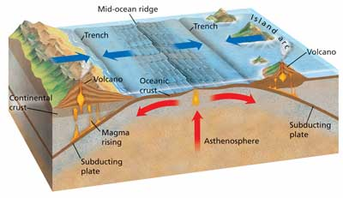
The ocean floor
The ocean floor is not a flat.
Deep-ocean trenches – form the deepest part of the oceans. They occur on the edges of oceans near continents.
Mid-ocean ridges – a long chain of mountains in the center of oceans.
Rift valley – a central valley occurring in the middle of a mid-ocean ridge. It looks like a canyon.

Slide 14
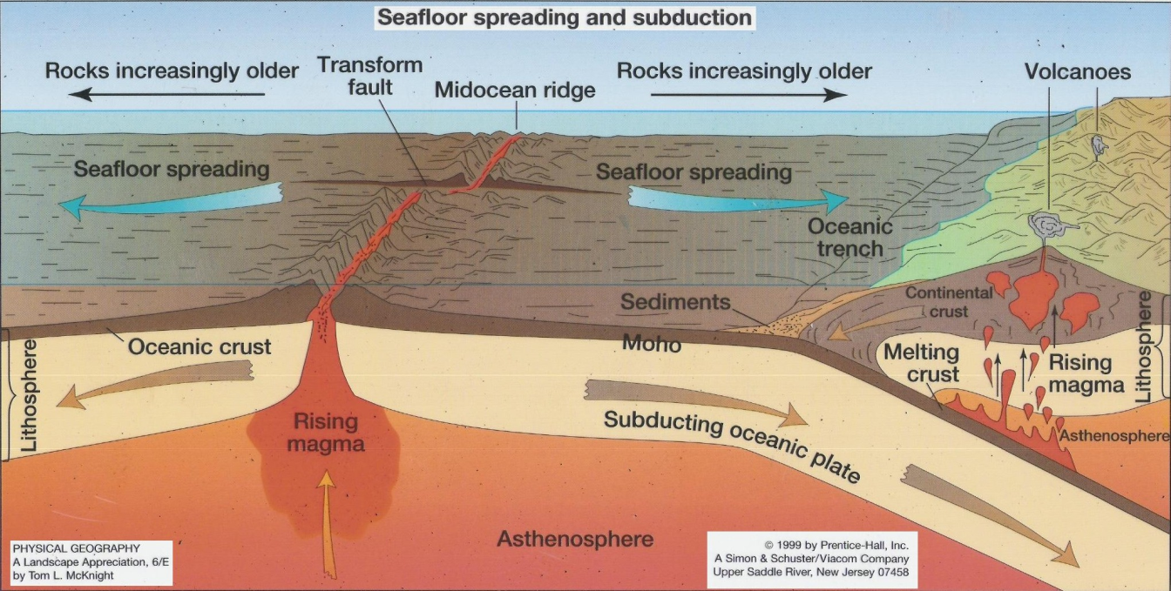
Seafloor spreading
What is seafloor spreading? Think of a conveyer belt at the grocery store…
Magma gets pushed out of the mid-ocean ridge (long mountain chain).
The magma spreads out along each side. It cools and hardens into rock (oceanic crust).
More lava forms at the mid-ocean ridge, pushes the older stuff outward.
The result? – Oceanic crust is young in the middle and old on the outside.

Slide 15
Evidence for seafloor spreading
Sea-floor spreading explained how ocean basins can grow wider or close up.
What evidence is there for sea-floor spreading?

Slide 16
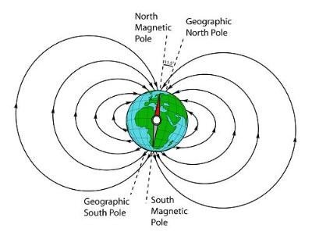
1. Magnetic strips
Magma that cools and forms the ocean floor is rich in iron.
When the magma cools the grains in the rocks line up with the earth’s magnetic field.
Paleomagnetism – rocks acquire the polarity of the earth’s magnetic field at that time.

Slide 17
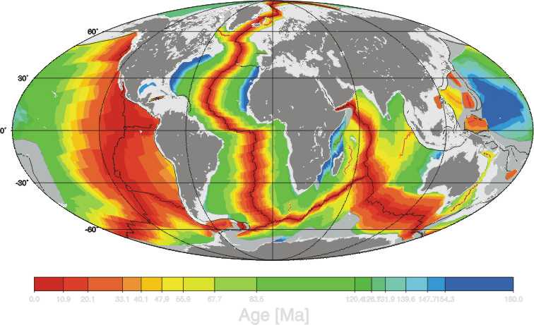
2. Age of ocean Floor
Age of the ocean floor
Ocean floor is youngest along the rift valley of the mid-ocean ridge.
Ocean floor is oldest in the subduction zones or near the continents.
How does the thickness of the crust change as you move away from the ridge?

Slide 18
Check for understanding
How do ridges and trenches support the theory of seafloor spreading?
How are ocean-floor rocks and sediments evidence of seafloor spreading?
How do magnetic strips support seafloor spreading?
What would Wegener say after seeing this evidence?
Notes:
2. Tickness and age

Slide 19
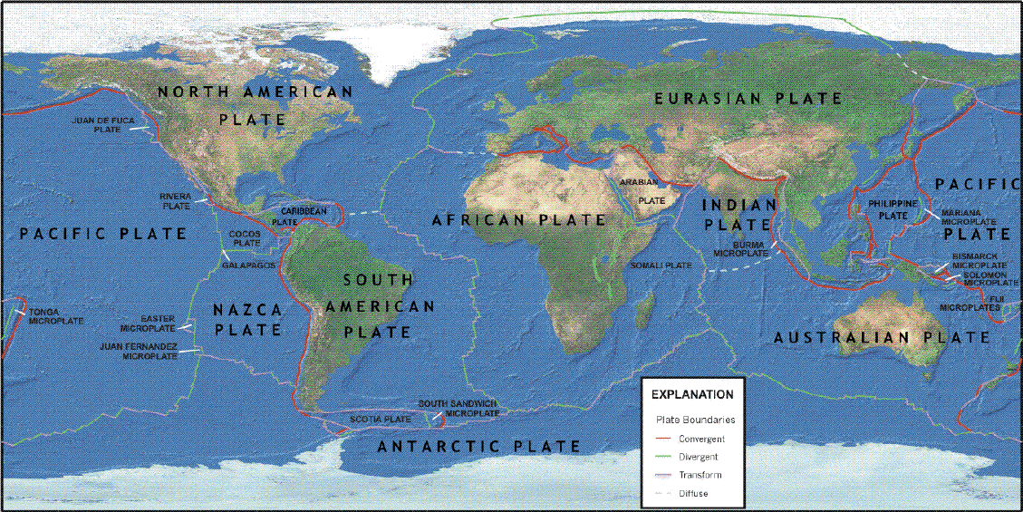
17.3 Theory of Plate tectonics
The lithosphere is broken into several huge pieces called plates.
Deep faults separate the plates.
Theory of Plate Tectonics: earth’s crust is broken up into lithospheric plates and those plates are constantly moving slowly relative to each other, driven by convection currents in the mantle.

Slide 20
Plate boundaries
There are three types of plate boundaries
Divergent
Convergent
Transform

Slide 21
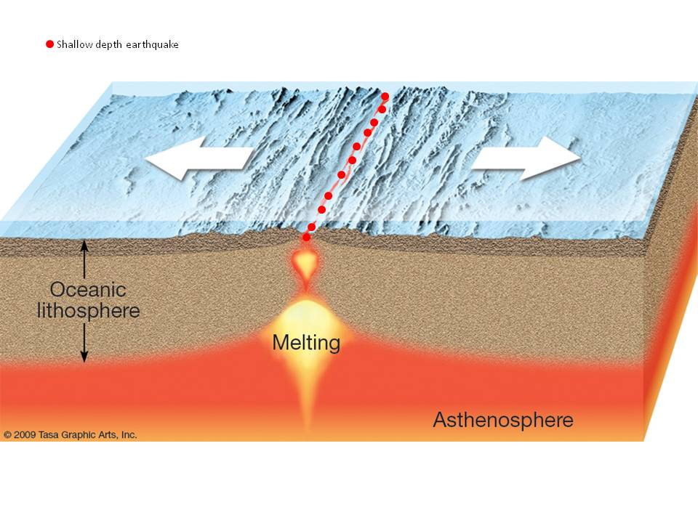
Plate Boundaries
Divergent boundary – a boundary where two of earth’s plates move away from each other.
Oceanic crust is created at divergent boundaries.
Rift valley and mid-ocean ridges are formed

Slide 22
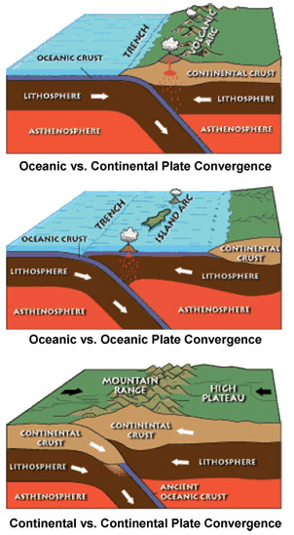
Plate boundaries
Convergent boundary – a boundary where two plates collide.
Ocean – Ocean resulting in volcanic island arc
Ocean – Continental resulting in volcanic mountains
Continental – Continental resulting in non volcanic mountains
Subduction Zone

Slide 23
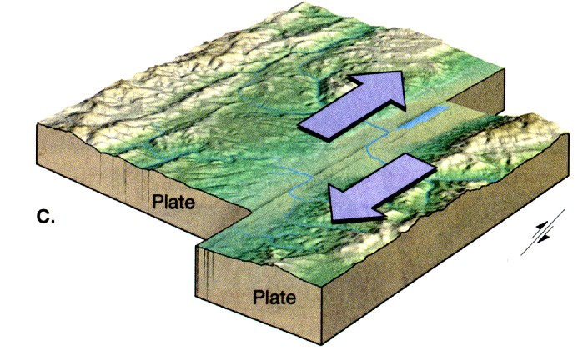
Plate boundaries
Transform fault boundary – a boundary where two plates slide past one another but crust isn’t created or destroyed.

Slide 24
Check for understanding
Explain the theory of plate tectonics.
List the three types of plate boundaries and describe what happens at each.
The ocean floor has been compared to a conveyer belt. Defend this comparison.

Slide 25
17.4 Mechanisms of plate motion
Convection current – the continuous flow that occurs in a fluid because of differences in density. Warm material is less dense so it rises. Cooler material is denser so it sinks.
Convection currents in the mantle provide the basic driving forces for plate motions.
Oceanic crust is coldest and most dense farther away from the mid-ocean ridge. This is known as “slab-pull.”
Near mid-ocean ridges, the asthenosphere is elevated. Oceanic crust slides down this elevation. This is known as “ridge-push.”

Slide 26
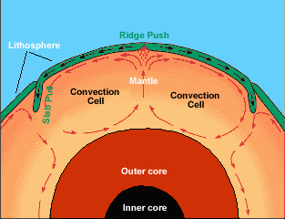
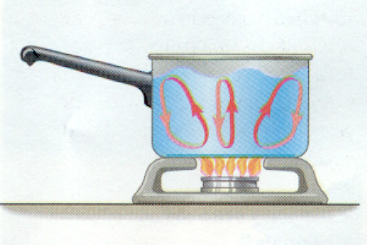
Plate motion…
Convection currents within the earth drive plate motion.
Hot material within the mantle moves upward. At the same time, cooler, denser slabs of oceanic lithosphere sink back into the mantle.

