Slide 1
Sticky Note Q’s
Unit 4 2021

Slide 2
OBJECTIVE 1
Subatomic Particle | Mass | Charge | Location | Affects what?
proton
neutron
electron
Ion vs Isotope –
What is the difference?
What are examples of each?
How are they formed?

Slide 3
OBJECTIVE 2
Element Symbol | Mass Number | Atomic Number | # Electrons | # Protons | # Neutrons
 | 32 | 16
 |  | 20 | 18 |  | 20
²³Na⁺¹
 |  |  |  | 50 | 69
When do I use the atomic mass found on the periodic table? When do I round?

Slide 4
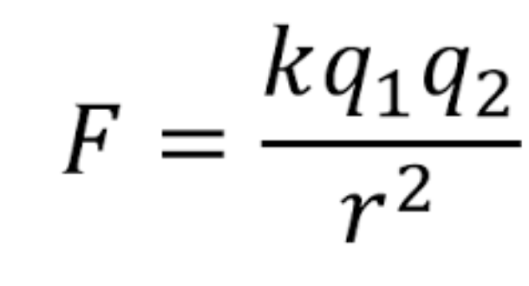
OBJECTIVE 3
What is Coulomb’s Law? What two factors affect the electric force?
What is the strong force?
How do the electric force and the strong force hold an atom together?
Which force “wins” in a stable atom?
Which force “wins” in an unstable atom?
What would cause the instability?

Slide 5
OBJECTIVE 4 (decay)
Why do radioisotopes decay? What is their ultimate goal?
Complete these decay reactions:
Beta Plus: C-11 →
Beta Minus: H-3 →
Gamma: Ba-137 →
Alpha: Am-241 →

Slide 6
OBJECTIVE 4 (nuclear reactions)
3. How are fission and fusion alike?
4. How are they different?
5. What are some examples in life?
6. What is E=mc²

Slide 7
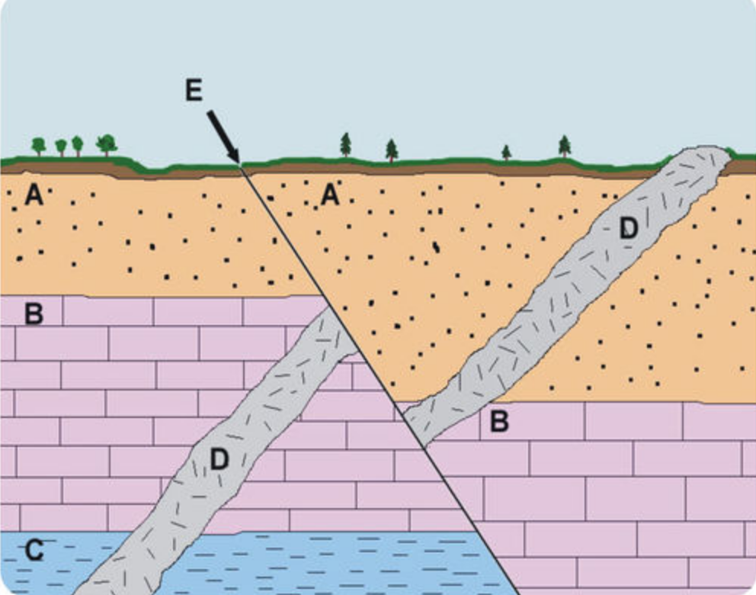
OBJECTIVE 5
What is the difference between absolute and relative dating?
Put the layers of rock in order. Explain.
If you start with 12g of a sample, how much will be left after:
1 half-life ______
2 half-lives ______
3 half-lives ______
If you have 3g of parent and and 21g of daughter, how many half-lives have passed? ____ If the half-life is 14 days, how old is the sample?
What are index fossils? How do they help us read the rock record?

