Slide 1
Sticky Note Q&A’s
Unit 4 2021

Slide 2
OBJECTIVE 1
Subatomic Particle | Mass | Charge | Location | Affects what?
proton | 1 amu | +1 | In nucleus | element
neutron | 1 amu | 0 | In nucleus | Mass, isotope, stability
electron | 0 amu | -1 | Outside nucleus | Charge, ion, properties of element
Ion vs Isotope –
What is the difference?
What are examples of each?
How are they formed?
Notes:
Ion – charged atom; positive ion – losing e-, negative ion – gaining e- (Ca⁺², Cl⁻¹)
Isotope – same element, different mass due to a different number of neutrons (C-12, C-14) some occur in nature, some are synthetic; affect stability

Slide 3
OBJECTIVE 2
Element Symbol | Mass Number | Atomic Number | # Electrons | # Protons | # Neutrons
³²S | 32 | 16 | 16 | 16 | 16
⁴⁰Ca⁺² | 40 | 20 | 18 | 20 | 20
²³Na⁺¹ | 23 | 11 | 10 | 11 | 12
¹¹⁹Sn | 119 | 50 | 50 | 50 | 69
When do I use the atomic mass found on the periodic table? When do I round?

Slide 4
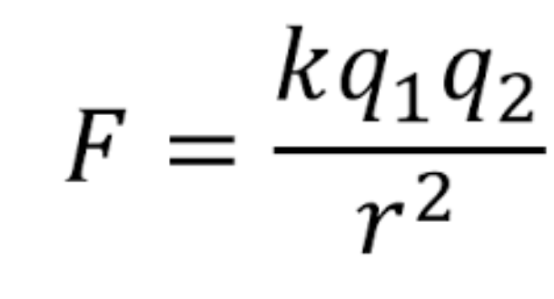
OBJECTIVE 3
What is Coulomb’s Law? What two factors affect the electric force?
What is the strong force?
How do the electric force and the strong force hold an atom together?
Which force “wins” in a stable atom?
Which force “wins” in an unstable atom?
What would cause the instability?
Notes:
Relates charge and the distance between the charges to the electric force. Increasing the charge or decrease the distance between them, then the force increases. Like charges repel, opposite charges attract
Strong force is what holds the nucleus together, 100x stronger than electric force, acts between p & p, n & n, p & n
Electric force holds onto the electrons. Strong force keeps nucleus together. Electric force also acts on nucleus by repelling the protons.
In a stable atom, the strong force wins.
In an unstable atom, the electric force wins.
Neutron:proton ratio out of whack, or if the atom is too large and the strong force cannot withstand the electric force

Slide 5
OBJECTIVE 4 (decay)
Why do radioisotopes decay? What is their ultimate goal?
Complete these decay reactions:
Beta Plus: C-11 → e⁺ + B-11
Beta Minus: H-3 → e⁻ + He-3
Gamma: Ba-137 → Y + Ba-137
Alpha: Am-241 → ⁴He + Np-237
Notes:
1. Radioisotopes decay because they are unstable and trying to get to a stable isotope.

Slide 6
OBJECTIVE 4 (nuclear reactions)
3. How are fission and fusion alike?
4. How are they different?
5. What are some examples in life?
6. What is E=mc²
Notes:
3. Fission and fusion both give off a lot of energy
4. Fission is the splitting of a large nucleus into two smaller nuclei, while fusion is 2 small nuclei coming together to form 1 larger nucleus
5. Fission: nuclear reactor, atomic bomb; Fusion: stars, hydrogen bomb
6. shows that the energy released during fission and fusion is extremely large (happens to be much larger than any chemical reaction)

Slide 7
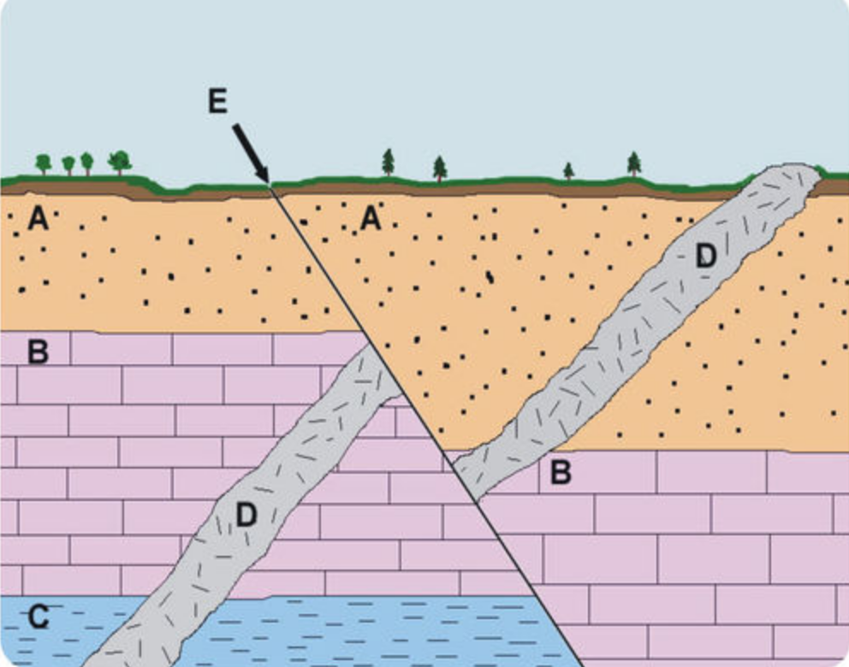
OBJECTIVE 5
What is the difference between absolute and relative dating?
Put the layers of rock in order. Explain.
If you start with 12g of a sample, how much will be left after:
1 half-life __6g____
2 half-lives __3g____
3 half-lives __1.5g____
If you have 3g of parent and and 21g of daughter, how many half-lives have passed? __3__ If the half-life is 14 days, how old is the sample? 42 days
What are index fossils? How do they help us read the rock record?
Notes:
Absolute dating gives a number: parent:daughter ratio, determine # of half-lives, multiply half-life by # of half-lives; relative compares layers to each other (puts them in order) using original horizontality, cross-cutting relationships (intrusions and faults), superposition.
Oldest → youngest: C, B, A, D, E
6g, 3g, 1.5g
24g → 12g → 6g → 3g (3 half-lives); 42 days old
Index fossils: fossils that are only found for a short period of time but are widespread; the age of the fossil will be similar to the age of the rock layer

