Slide 1
Sticky Note Q’s
Unit 5 2019

Slide 2
OBJECTIVE 1
What are the equations we will need to know? Will they be given on the exam?
A wave has a frequency of 15 Hz and a wavelength of 2.0x10² cm. What is the speed of the wave?
Maria bounces the ball up and down 3 times in 2.0 seconds. What is the frequency of her bouncing? Period?
A standing wave in lab has a frequency of 24.0 Hz and is set up on a string 3.22 meters apart. There were 7 segments. What is the speed of the wave?
How do you find amplitude?
Review DA?

Slide 3
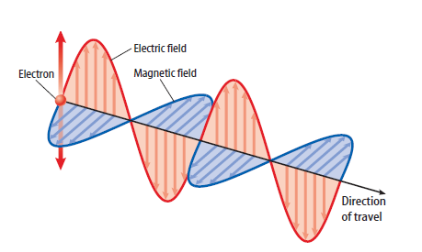
OBJECTIVE 2
What do we need to know about EM waves?
How are they produced?
What do they look like?
What is the relationship between the electric field and the magnetic field?
a. When an electric charge vibrates, the electric field around it changes. b. The changing electric field induces a changing magnetic field. A changing magnetic field induces a changing electric field. c. This process continues over and over. d. The electric and magnetic fields are perpendicular to each other and travel outward

Slide 4
OBJECTIVE 3
What do we need to really know about this objective? What assignment/discussion did we have that covers this objective?
AM/FM Radio?? Music and voices are changed into electronic signals → coded onto radio waves → broadcast AM = amplitude modulation → amplitude is varied FM = frequency modulation → frequency varied Our radio receives it, decodes it, and changes it back to sound waves to hear. (page 541 Physical Science book)
Think Wave Tech Activity....Remotes, Bluetooth, Wifi, etc. all use EM waves. Which frequencies/wavelengths were most used? Why? What challenges does this bring?
Think Laser Wave Demo in terms of transmitting information via EM waves and converting it into other forms of Energy

Slide 5
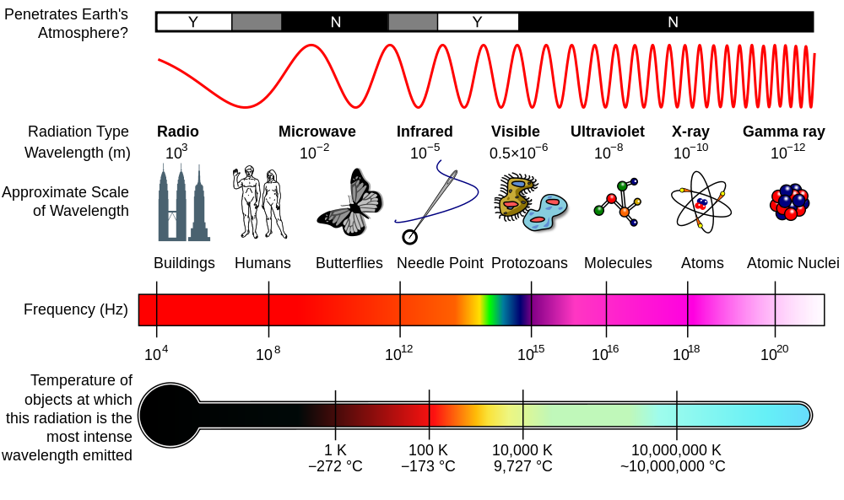
OBJECTIVE 4
What all does this objective include? Discuss frequency, wavelength, and energy.

Slide 6
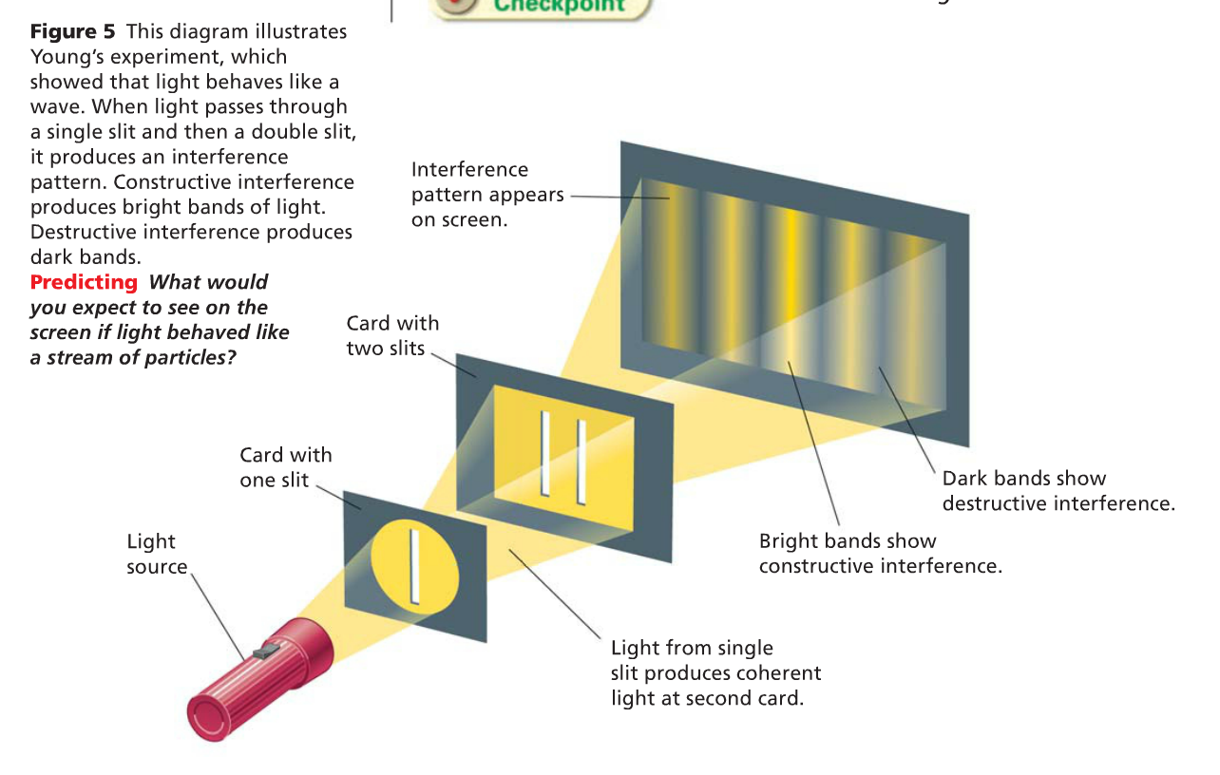
OBJECTIVE 5 – I just need more…
What wave behaviors do we see with this experiment?
Why does this experiment “rule out” light as particles?

Slide 7
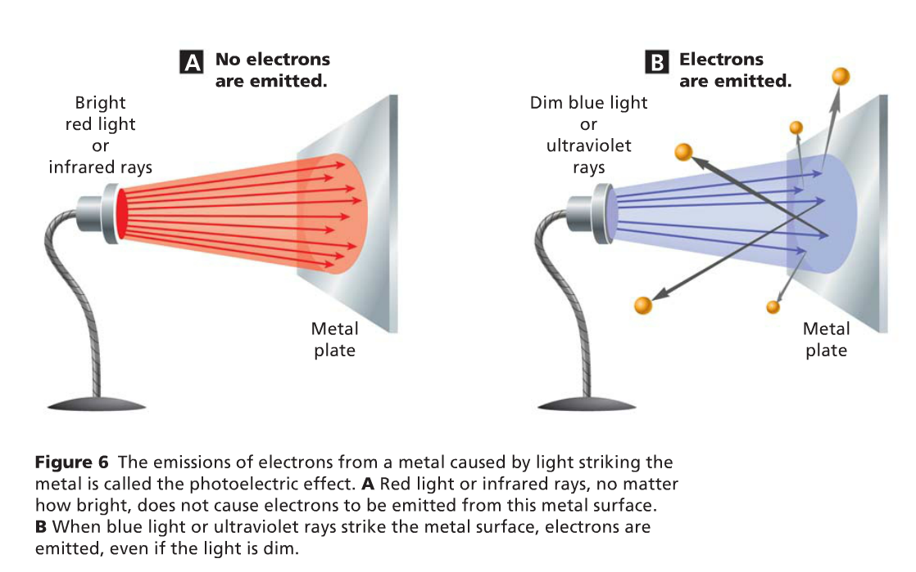
OBJECTIVE 6
Why does this experiment ”rule out” light as waves?

Slide 8
OBJECTIVE 7
What are the main ideas for this objective?
EX: Sun light is EM radiation (mixture of UV, infrared, visible light)
How does the metal part of a seatbelt feel in the summer on a hot day?
Why? What wave behavior is this?
How is this an example of waves changing into other forms of energy?
Other EX: Solar Energy, Photosynthesis, Ocean Waves, Laser Music Demo

Slide 9
Laser Music Demo Explained…
Information is embedded in waves with modulation to encode an audio signal in a laser beam using a transformer.
We observe how the transformer amplifies an audio signal → signal is transmitted across the room via a laser pointer → converted by a photovoltaic cell into electricity → converted back into an audio signal through a dynamic speaker acting as a transducer.

