Slide 1
Sticky Note Q’s
Unit 6 2020

Slide 2
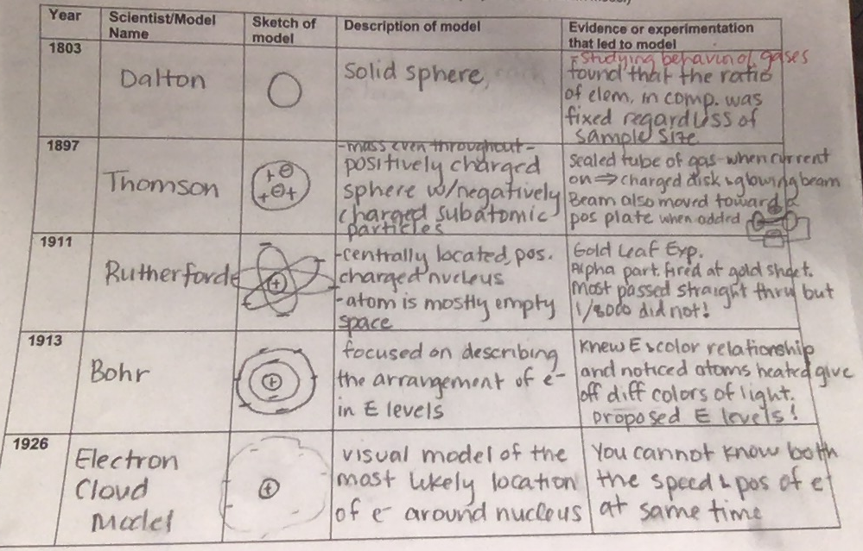
OBJECTIVE 1
Regarding the atomic theory, what discoveries have been made?
Notes:
Dalton’s Atomic Theory:
All elements are composed of atoms.
Atoms of the same element are alike.
Atoms of different atoms are all different. Thomson – positive and negative components of atom - electrons Rutherford – positive, centrally located nucleus, atom mostly empty space Bohr – energy levels Quantum model – e- cloud

Slide 3
Objective 2
What is malleability?
Properties of metals vs nonmetals?
Halogen? Alkali Metal?

Slide 4
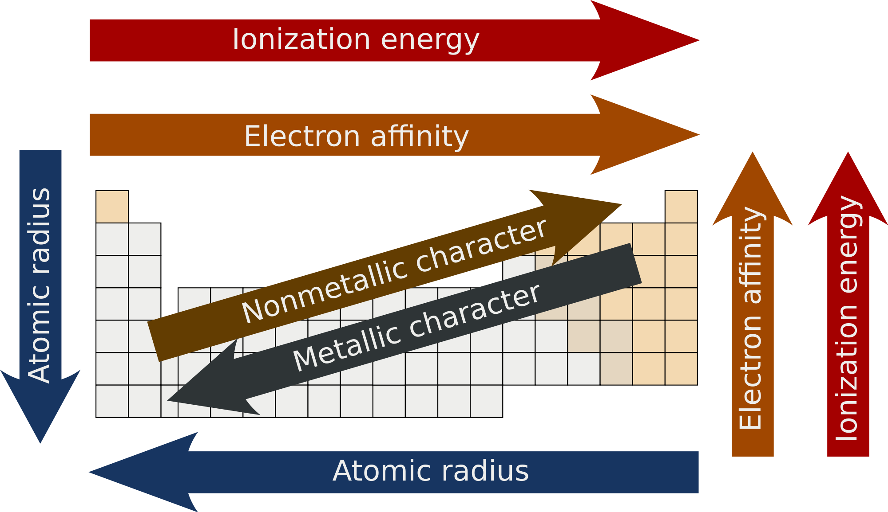
OBJECTIVE 3
Describe the atomic radius trend on the periodic table. Explain.
Describe the EN trend on the periodic table. Explain.
What is the relationship EN differences and the bond that will form?
Compare and contrast oxidation states and valence electrons.
What is the ox #?
Electronegativity
Electronegativity
Notes:
If the EN values differ between 0-0.4 → covalent
If the EN values differ between 0.4-1.7 → polar covalent
If the EN values differ between 1.7 + → ionic

Slide 5
OBJECTIVE 4
Ionic compounds: metal + nonmetal, brackets, charges, transfer e-, coefficient if needed
Practice: Draw ions. *Dot diagram vs. Lewis Structure? Na & Br Mg & I Li & S Mg & O
Explain how metals satisfy the octet rule when bonding with a nonmetal.
Why do a metal & nonmetal form an ionic bond?
What is a cation? Anion?
Notes:
Metals give away their valence e-, lose their outer energy level, and go down to the next one which has 8.
Metals have a low EN (attraction to valence e-) while nonmetals have a high EN. Metals give away their outer e- and nonmetals gladly receive them. They need to satisfy the octet rule.

Slide 6
OBJECTIVE 5
Covalent compounds: 2 nonmetals, connect dots, share e-, add atoms as needed to satisfy octet rule
Practice: Draw Lewis Structures. Which bonds are polar? Why? What does this mean? H & F Cl & Cl H & O O & O
How do nonmetals satisfy the octet rule when bonding with another nonmetal?
Why do 2 nonmetals form a covalent bond?
Polar bond vs polar molecule?
Notes:
Nonmetals share electrons with other nonmetals in order to fill their outer energy level. This could mean a single, double, or triple bond.
Nonmetals have a high EN (attraction to valence e-). If you have two elements that are both holding on tightly to their valence e-, they are more likely to share than to give up the e-. They have to satisfy the octet rule.

Slide 7
OBJECTIVE 6
Ionic Compounds Props | Covalent Compounds Props
Made of metal and nonmetal | Made of nonmetal and nonmetal
One atom takes e-, one loses e- | Atoms share e-
Higher melting and boiling points | Lower melting and boiling points
Generally solids at room temp | Often liquids and gases at room temp
Usually hard/brittle | Often softer
Conducts electricity | Does not conduct electricity
Dissolves readily in water | Does not dissolve readily in water

Slide 8
OBJECTIVE 7 & 8
Balance and label the type of reaction. Predict the product if no product is given.
Al₂(SO₄)₃ + Ca(OH)₂ → Al(OH)₃ + CaSO₄
C₆H₆ + O₂ → CO₂ + H₂O
Ca + KCl →
Cl₂ + KI →
Fe + O₂ → Fe₂O₃
H₃PO₄ → H₄P₂O₇ + H₂O
Why do we balance chemical equations?

Slide 9
OBJECTIVE 9 – “would be nice to go over this objective” I agree :)
What factors affect reaction rates?
Adding a magnesium strip to vinegar will cause it to fizz. How could I test the affect temperature has on the reaction rate? What would you predict and why?
Adding an Alka Seltzer to water causes a chemical reaction. What are two ways to affect the reaction rate?
For the reaction of zinc metal with hydrochloric acid, explain why:
a. Concentrated hydrochloric acid reacts at a faster rate than dilute hydrochloric acid.
b. Zinc powder reacts faster than pieces of zinc.
c. The reaction occurs faster at 60 degrees C than 20 degrees C.
Notes:
Concentration – increase reactants → more collisions → increase reaction rate
S.A. – increase surface area → more chances to collide → increase reaction rate
Temperature - increase temp → faster particles → more collisions → increase reaction rate
Catalyst – acts as a matchmaker for reactants (lowers activation energy needed for the reaction to occur)

